Slide 1
Hyfforddiant yng Nghymru yw'r gorau yn y DU – trafodwch Training in Wales is the best in the UK - discuss
Yr Athro Prof. Push Mangat,
Cyfarwyddwr Meddygol Medical Director
Dr Anton Saayman, Cyfarwyddwr Gwelliant Addysgol (Deoniaeth Feddygol)
Director of Educational Improvement (Medical Deanery)

Slide 2
Beth ydym ni'n ei wybod? What do we know?
Fill rates, attrition & recruitment
Pharmacy-155 trainees recruited for 2020 intake (96 in 2019)
Fill rate for Wales 97% vs average 65% fill rate in England
Nursing – 2704 places certain, expected 95-98% fill rate
79% Domiciled in Wales
Attrition rate low v England
90% qualified with 2:2
GP- 604 GP Registrars (512 in 2019)
Secondary Care – increase F1, Radiology, Emergency Medicine, CMT, Anaesthetics & ICU etc
Dental- 62/62 DFT, 67/71 DCT and 20/21 DST
Non Training grade
Associate Dean SAS, SAS Tutors
Partnerships
HEIs, NHS bodies, Improvement Cymru

Slide 3
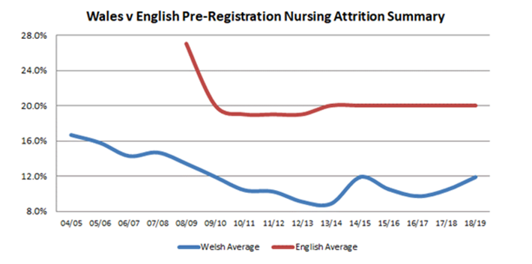
Beth ydym ni'n ei wybod? What do we know?
Valuing Trainees and Students
Nursing & AHP attrition rates low
Differential Attainment Board
Single Lead Employer
GMC Trainee Survey
Wales highest overall satisfaction of UK
82.38%
Training Environment

Slide 4
Arloesi i wella hyfforddiant Innovations to improve training
Pre Reg Pharmacy Training Programme
HEIW quality managed, multi-sector programme LIFT
Early integration of FP trainees into General Practice 2 plus 1
Increasing GP training time in practice Differential Attainment
DA Board collaborating with stakeholders, regulators SL rollover
LEP agreement to roll over unspent study leave following COVID ARCPs
Virtual ARCPs, decision aids

Slide 5
Sicrhau rhagoriaeth hirdymor Ensuring long term excellence
Commissioning
Pilot of multiprofessional commissioning, focus on workforce and commissioning for quality SIM
Multiprofessional SIM Team, all Wales remit Digital
Platforms for teaching, training and meeting. Virtual delivery
Research, Evaluation
Working towards embedding skills within HEIW and collaborating with HEIs and LEPs
Improvement & Innovation
QIST programme an exemplar, Improvement in Practice

Slide 6
Diolch Thank you

