Slide 1
Gwireddu Uchelgais
Realising Ambition
Llwybrau i mewn ac allan o Addysg a Hyfforddiant yng Nghymru
Routes in and out of education and training in Wales
Angela Parry
Pennaeth Nyrsio Dros Dro
Director of Nursing
Angie Oliver
Dirprwy Gyfarwyddwr Datblygu'r Gweithlu a DG
Deputy Director of Workforce
& Organisational Development

Slide 2
Dull Traddodiadol Traditional Approach
School
Job
Retire
University
But what if……
I wasn’t fully aware of the opportunities when I chose my course.
I made the wrong choice.
This career isn’t for me.
Now is not my time.
Am I really stuck here for best part of 50 years?
Notes:
Points to note
Things are changing, Donaldson curriculum, building in careers throughout the curriculum
HEIW is invested in a national careers service for NHS Wales – works with education, Dept Work and Pensions, Veterans, Schools, Careers Services, Volunteering
Widening Access is key – across all areas of health (and social care)
Much longer careers – ½ century is a long….long…..time
Not unusual to have 2 or more careers within a lifetime
Second chance?
Reality of balancing work, life, financing, training to do new careers
I’m going to show you a story………

Slide 3
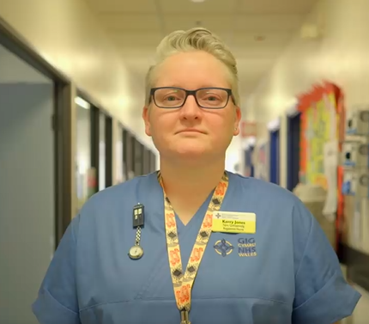
Gwireddu Uchelgais: Sut olwg sydd ar lwyddiant?
Realising Ambition: What does success look like?
Stori Kerry’s Story
https://www.facebook.com/HywelDdaHealthBoard/videos/396731784221168/
Notes:
Points to Note
Listen to this story
How HEIW helped to change this story
How we will change other stories
Age is no barrier – 54 starting eduction (Kerry was 47)
Background and previous education skill is no barrier
If you have the dream…..we can help make it a reality

Slide 4
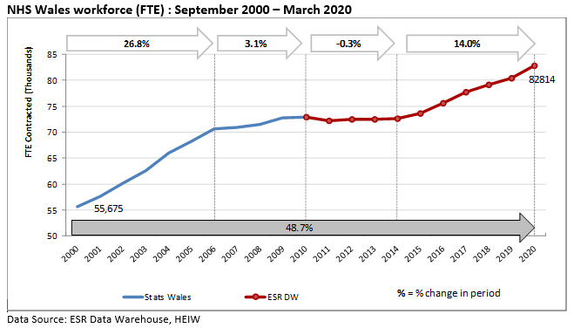
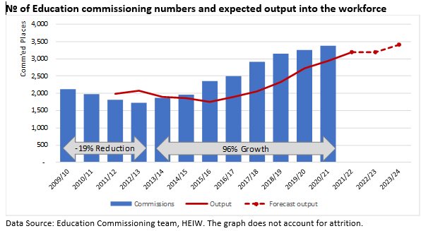
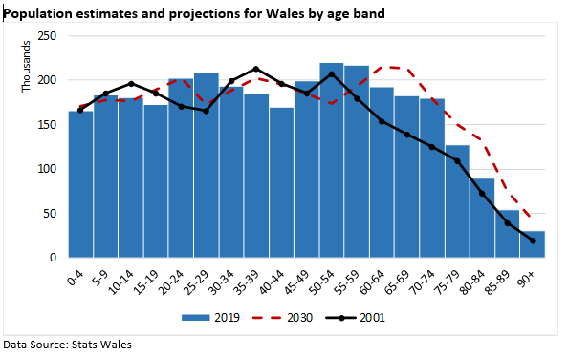
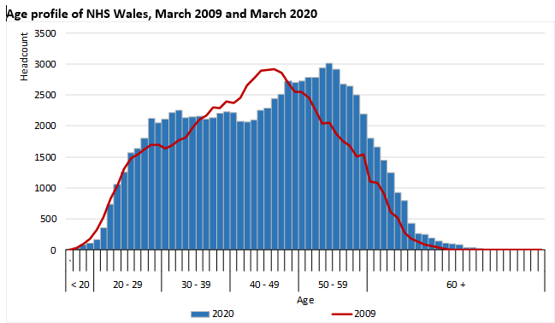
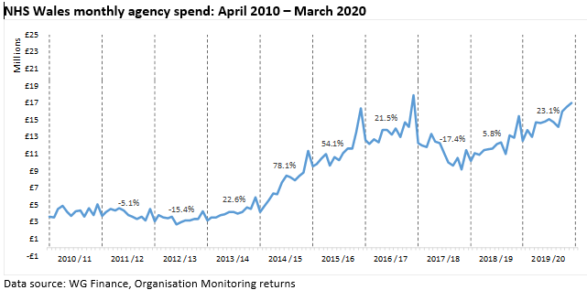
Ein Gweithlu – pobl Cymru
Our Workforce – the people of Wales
Notes:
Points to Note
More people than ever in the NHS
More education commissioned than ever
Population curve shifting to the right (age)
Working longer

Slide 5

Gall fod yn wahanol – sut rydym yn newid y stori
It can be different – how we are changing the story
Changing the shape of our workforce
Apprenticeships
Supporting Newly Qualified Staff
Continuous learning
Flexible learning
Work-based learning
Transferrable learning
Extended skills
Commissioning Education differently
Once for Wales
Resilience
Dispersed learning
Digital solutions
Widening Access
Flexible learning
Enabling our people to realise their dreams
Delivering workforce transformation and sustainability
Notes:
Points to Note
Learning doesn’t stop with registration
Empower the learner to make career choices
Learning helps cross over to other careers
Whole system, once for Wales approach
with regional variation
Building resilience into the system
Tripartite working arrangements
Distance and dispersed learning
Maximising digital solutions
Widening access
Tackling differential attainment
Flexible learning routes
New and innovative funding models
Core competences recognised
Recognised prior learning
Apprenticeships
Supporting Newly Qualified Staff Learning continues throughout career
Pathways become more flexible
Transferrable learning
Bite size learning
Step on, step off learning
Extend skills and knowledge
Regulatory Frameworks are more flexible

Slide 6

Gwnaed yng Nghymru – Y weledigaeth
Made in Wales – The vision
Typical Role (Wales)
Registered HCP
Graduate Entry Programmes (eg Graduate Entry Medicine, MSc in Nursing)
Asst. Practitioner
(B4)
All elements build to pre-registration
Degree Qualification
Level 6
(to be developed)
Pre-registration degree programme
2 years 9month part time
salary/
Secondment
Funding as per 4 yr part time programme
Pre-registration degree programmes
4 years part time
(22hrs p/w)
Fees = HEIW
+ 16 hours salary
HB/Trusts fund remaining 6 hours salary
(plus remaining hours as per substantive contract)
Pre-registration degree programmes
3 years full time
Fees Covered by HEIW
+ Student Bursary Available (no repayment)* in addition to student loan
Degree in Life or Social Sciences areas
Level 5
(to be developed
Senior HCA B3
Level 4 Certificate in Healthcare (1-2 years)
Fees = HEIW
HB = Salary
Clinical HCA B2
Level 3 Diploma/Apprenticeship
WG apprenticeship funding or HEIW/HB (incl. Lev 2Key Skills)* if apprenticeship funding not available - Staff on current salary
‘A’ Levels (or equivalent)
Level 2 Diploma / Apprenticeship
WG ‘apprenticeship’ funding or HEIW/HB if apprenticeship funding not available (incl. Lev 1 Key Skills) - Staff on current salary
GCSE incl. Eng & Maths (or equivalent)
Work Experiences, Cadet Schemes, Volunteering Schemes
Notes:
Points to Note
Talk through each section in turn which starts at the ‘now’ and ends as the ‘could be’

Slide 7

Diolch

