Slide 1

Healthy working relationships

Slide 2
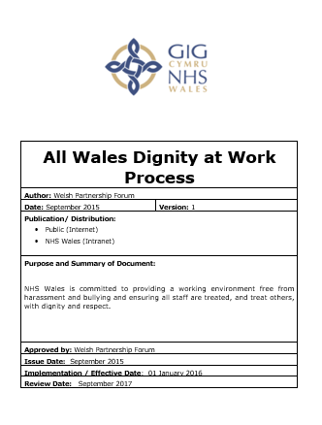
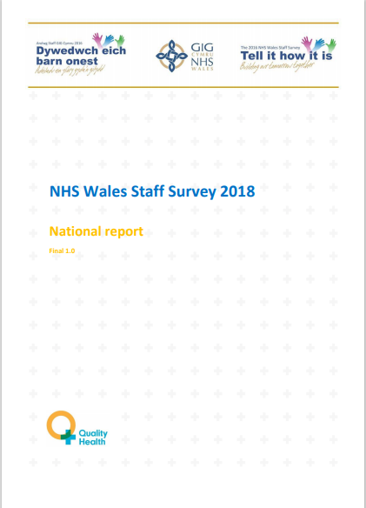
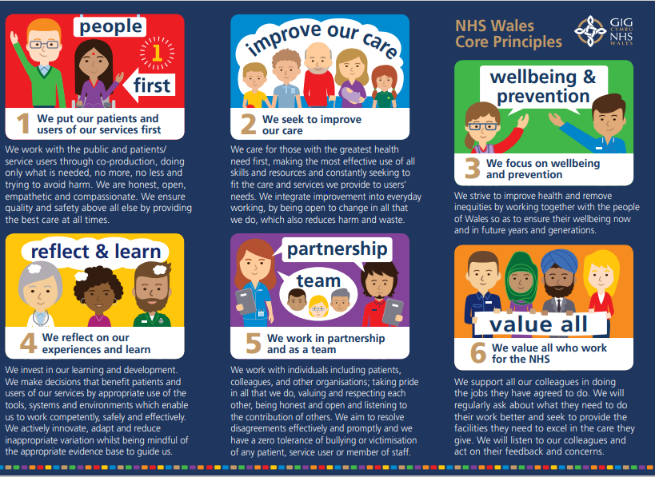
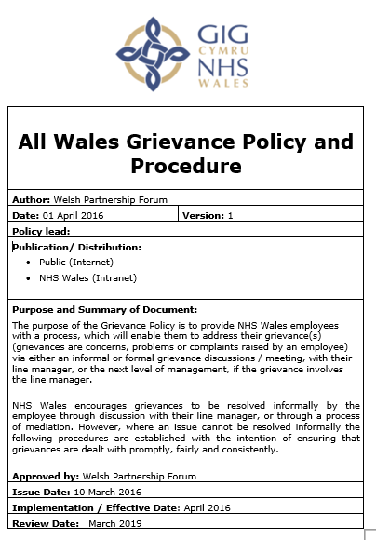


How did we get here?

Slide 3
What is rudeness and incivility?
Shouting
Talking over someone
Belittling
That’s just the way it is
I didn’t mean it like that
Undermining someone
Stubborn/non-cooperative
Aggression
Its always been like that
It is the interpretation of the recipient regardless of the intent

Slide 4
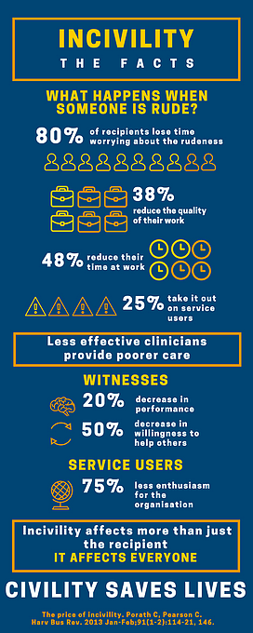
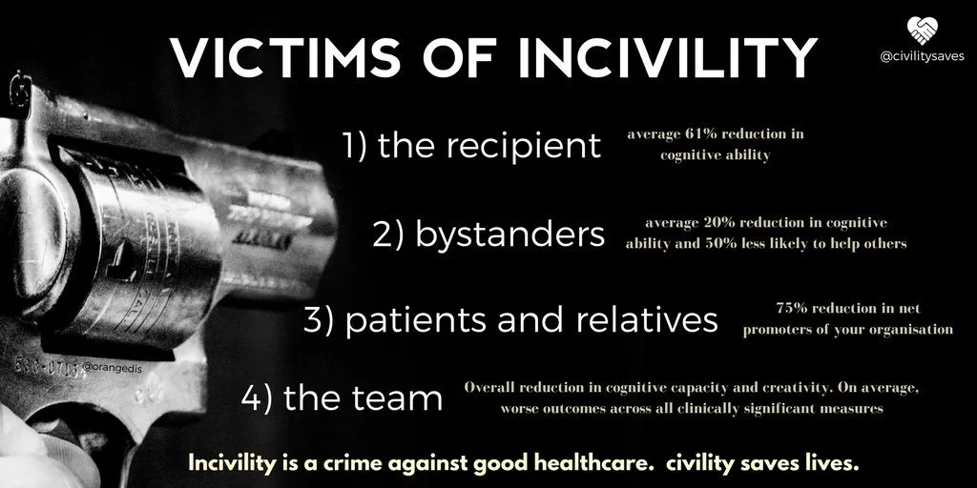
THE IMPACT OF INCIVILITY WITHIN THE NHS - CIVILITY SAVES LIVES

Slide 5
The two types of conflict
DYSFUNCTIONAL
Destructive
Harmful, stressful and costly
Can have a significant impact on psychological, emotional and physiological wellbeing
Difficult to manage
FUNCTIONAL
Constructive
Parties engaged in dialogue and focused on mutual acceptable outcomes (win/win)
Promotes understanding and leaning
Key component of high functioning and high performing teams

Slide 6
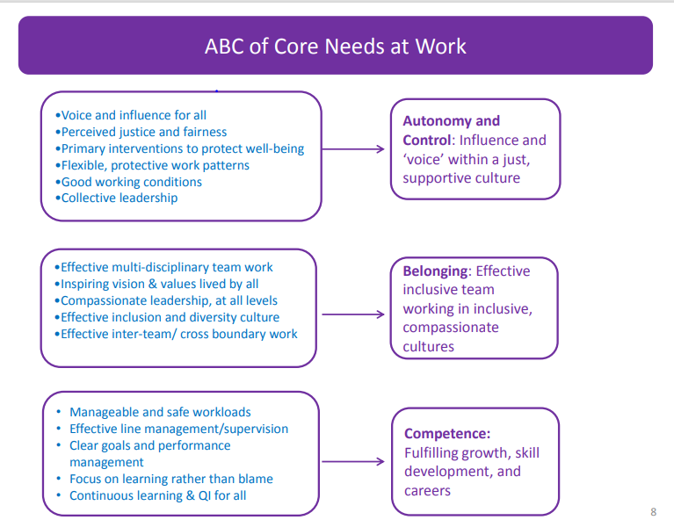
HWR & Compassionate leadership
Leadership Behaviours:
Attending; paying attention to staff – ‘listening with fascination
Understanding: shared understanding of what they face
Empathising
Helping: taking intelligent action to serve or help
West, M.S.,&Chowla, R. (2017). Compassionate leaderships for compassionate health care.

Slide 7
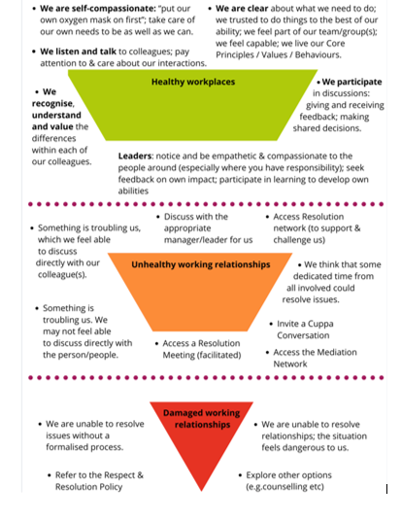
HEALTHY WORKING RELATIONSHIPS FRAMEWORK
Promotes compassionate and collective leadership approaches.
Where conflict exists, encourages resolution through dialogue.
Recognises that there is a place for a person-centered procedure when we are unable to resolve issues.

Slide 8
Respect and resolution policy
HWR recognises that not all conflict can be resolved informally.
There are occasions when we need to refer to more formal processes.
The new Respect and Resolution Policy will replace our current Grievance and Dignity at Work Policies.
ACAS compliant
The Healthy Working Relationships approach and supporting Respect and Resolution Policy has been ratified by Welsh Partnership Forum.
Supported by a set of FAQ’s and a flowchart

Slide 9
The reality of current grievance and dignity at work policies
The underlying issues are not being resolved.
Relationships are irrevocably damaged.
Inconsistency of the application of the rules by managers who are either not trained or supported adequately.
A blame culture emerges.
Take too long to generate an outcome
The parties, teams and overall organisation's needs are overlooked
Opportunities for insight, dialogue and transformation are missed
They generate stress, anxiety, depression and associated absence
DAVID LIDDLE, MANAGING CONFLICT

Slide 10
Respect and resolution policy
Policy is not the central part.
Focus is on resolving matters not on the procedural steps.
Section 3 – Informal Resolution
Section 4 – Formal Request for Resolution
Section 5 – Formal Resolution Meetings

Slide 11
Respect and resolution policy
Working FAQ document to support and guide.
Enabling managers to manage.
Benefits
  From and Organisational point
  From a TU/individual perspective.

Slide 12

Useful links
Healthy Working Relationships pages: Healthier relationships, work & workplaces - HEIW (nhs.wales)
Cuppa conversations: Cuppa Conversation – YouTube
Chris Turner: When rudeness in teams turns deadly | Chris Turner | TEDxExeter | TED Talk

