Slide 1
Cefnogi'r Tîm Amlddisgyblaethol ym maes Gofal Sylfaenol Supporting the Multi-Disciplinary Team in Primary Care Alex Howells, Prif Weithredydd Chief Executive Charlette Middlemiss Dirprwy Gyfarwyddwr Gweddnewid y Gweithlu Dros Dro Interim Deputy Director Workforce Transformation
Addysg a Gwella Iechyd Cymru
Health Education and
Improvement Wales

Slide 2
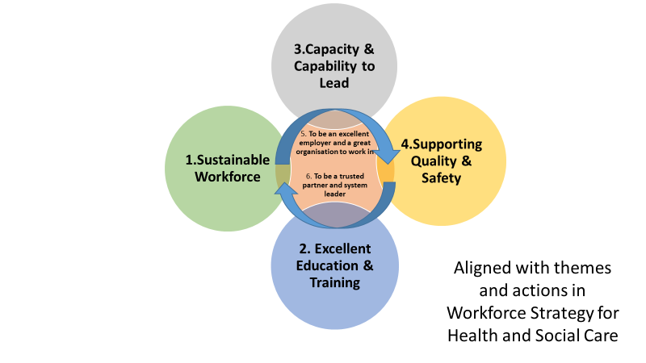
Amcanion Strategol AaGIC 20-23 HEIW Strategic Aims 20 - 23

Slide 3

Sut rydym yn bwrw ymlaen â gweithgareddau craidd? How are we getting on with core activities?
More opportunities to train
150 applications to become GP trainers from new and existing training practices
GP trainee target of 160 exceeded – 186 trainees recruited
GP training model offers more time in Primary Care: 1yr in hospital posts & 2yrs in general practice
Longitudinal Integrated Foundation Training programme; F1 doctors to spend one day a week in general practice placements
Pre-registration pharmacy training places up from 120 to 200 and will include experience of hospital, community and primary care settings.
MDT team development through interprofessional learning
Following successful pilot in 7 locations across Wales, Practice Based Small Group Learning (PBSGL) is being rolled out to clusters with funding to support sign-up.
Non-clinical education & training
First steps of career pathway development with launch of an accredited (level 2) Primary Care Administration and Reception (PCAR) qualification with funding to strengthen infrastructure - assessors and internal verifiers per Primary Care cluster.

Slide 4
Beth wnaethom i gefnogi gofal sylfaenol yn ystod Covid? What did we do to support primary care during Covid?
Digitally enabled solutions for trainee communications; education & training functions; and for recruitment to education & training programmes GP trainees given access to remote working capabilities via Microsoft Teams ‘lite’
Return to Practice Portal made available, giving access to online learning resources
Redeployment of trainees - 10 Dental Core trainees assisted in C&V Critical Care
Online training for dental professionals for redeployment to support C-19 pandemic
Virtual training and assessment to boost enhanced acute eye care optometrist numbers
HEIW Eye Care lead worked with Diabetic Eye Screening Wales (DESW) service and WAST to maintain access to, and flow through, minimised services during lockdown
Working in partnership with PHW, WG and service to deliver enhanced Infection Prevention & Control; and Immunisation training.

Slide 5
Sut rydym yn cyfrannu at y Rhaglen Strategol ar gyfer Gofal Sylfaenol? How are we contributing to the Strategic Programme for Primary Care?
Workforce planning requirements for primary care
Template, guidance and training GP recruitment
This year, not only was target met, but it was also exceeded with recruitment of 186 GP speciality trainees. General practice nurse career framework
Part of a larger strategic work programme to develop a multi-profession All Wales Learning and Development Framework ‘Once for Wales’ compendium of job descriptions / competencies
Work in collaboration with NWSSP, WNWRS & Job Evaluation to build a fresh resource. Practice Managers development
Practice management and administration toolkit supporting self- assessment and
development, as well as practice sustainability. New ways of working: impact to physical estates
Contributing evidence and expertise to discussions and plans

Slide 6
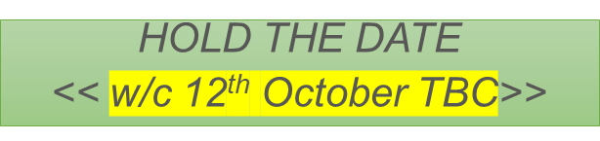
Beth yw ein cynlluniau i ddatblygu Canolfannau Hyfforddi Gofal Sylfaenol? What are our plans to take forward Primary Care Training Hubs?
To consider the following:
Hubs/Academies based on groupings of clusters within HB/RPB areas
Nationally funded infrastructure through HEIW to establish and operate a hub/academy model
Funding formula to recognise and reward education and training activities in primary and community settings
Potential for local systems to contribute additional funding and align existing resources to maximise benefits
Responsibility for hubs/academies shared between Health Boards and HEIW
Access to physical space – practices, resource centres, simulation facilities, digital platforms
HEIW to have an internal structure to oversee hub/academy framework in order to:
engage national partners (professional bodies, regulators, PHW, SCW, WG)
provide support and direction
provide educational governance
support overall management of clinical placements

