Slide 1
Canllaw i Feddygon Sylfaen sy’n dechrau ym mis Awst 2022 A guide for Foundation Doctors commencing August 2022

Slide 2
Croeso Welcome
We aim to ensure that you enjoy your time as a Foundation Doctor with the Wales Foundation School and have written this guide so you are aware of what you can expect and what is expected of you as a Foundation Doctor. This guide contains just some of the key information that you will need throughout your Foundation training. In addition to the guide, the Wales Foundation School will send monthly email bulletins and regular updates.
Your local Foundation Programme Director (FPD) and administrator will provide you with key information throughout the Programme, but should you have any queries that cannot be answered locally, the team in the Wales Foundation School are only too happy to help. In the first instance please visit our website:- https://heiw.nhs.wales/education-and-training/foundation/
If you are unable to find the answer on our website, please contact HEIW.FoundationSchool@wales.nhs.uk

Slide 3
Pobl hollbwysig Key people
Wales Foundation School / Health Education Improvement Wales (HEIW)
NWSSP
Foundation Programme Directors and Foundation Administrators
Educational and Clinical Supervisors
UKFPO

Slide 4
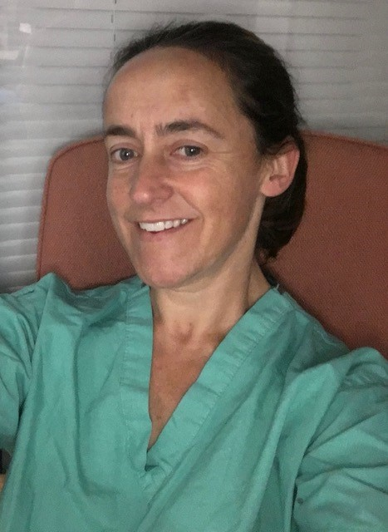
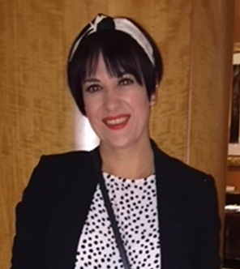
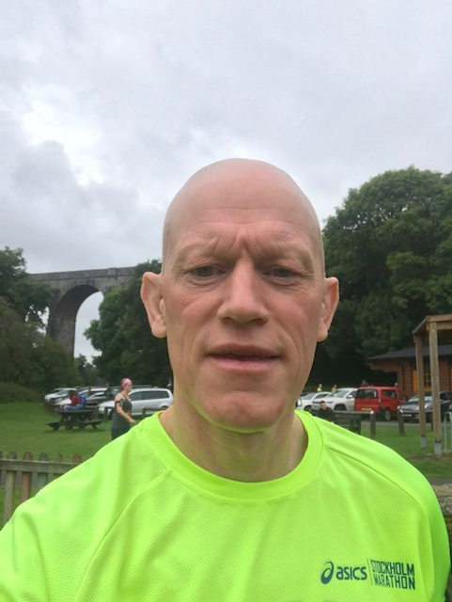
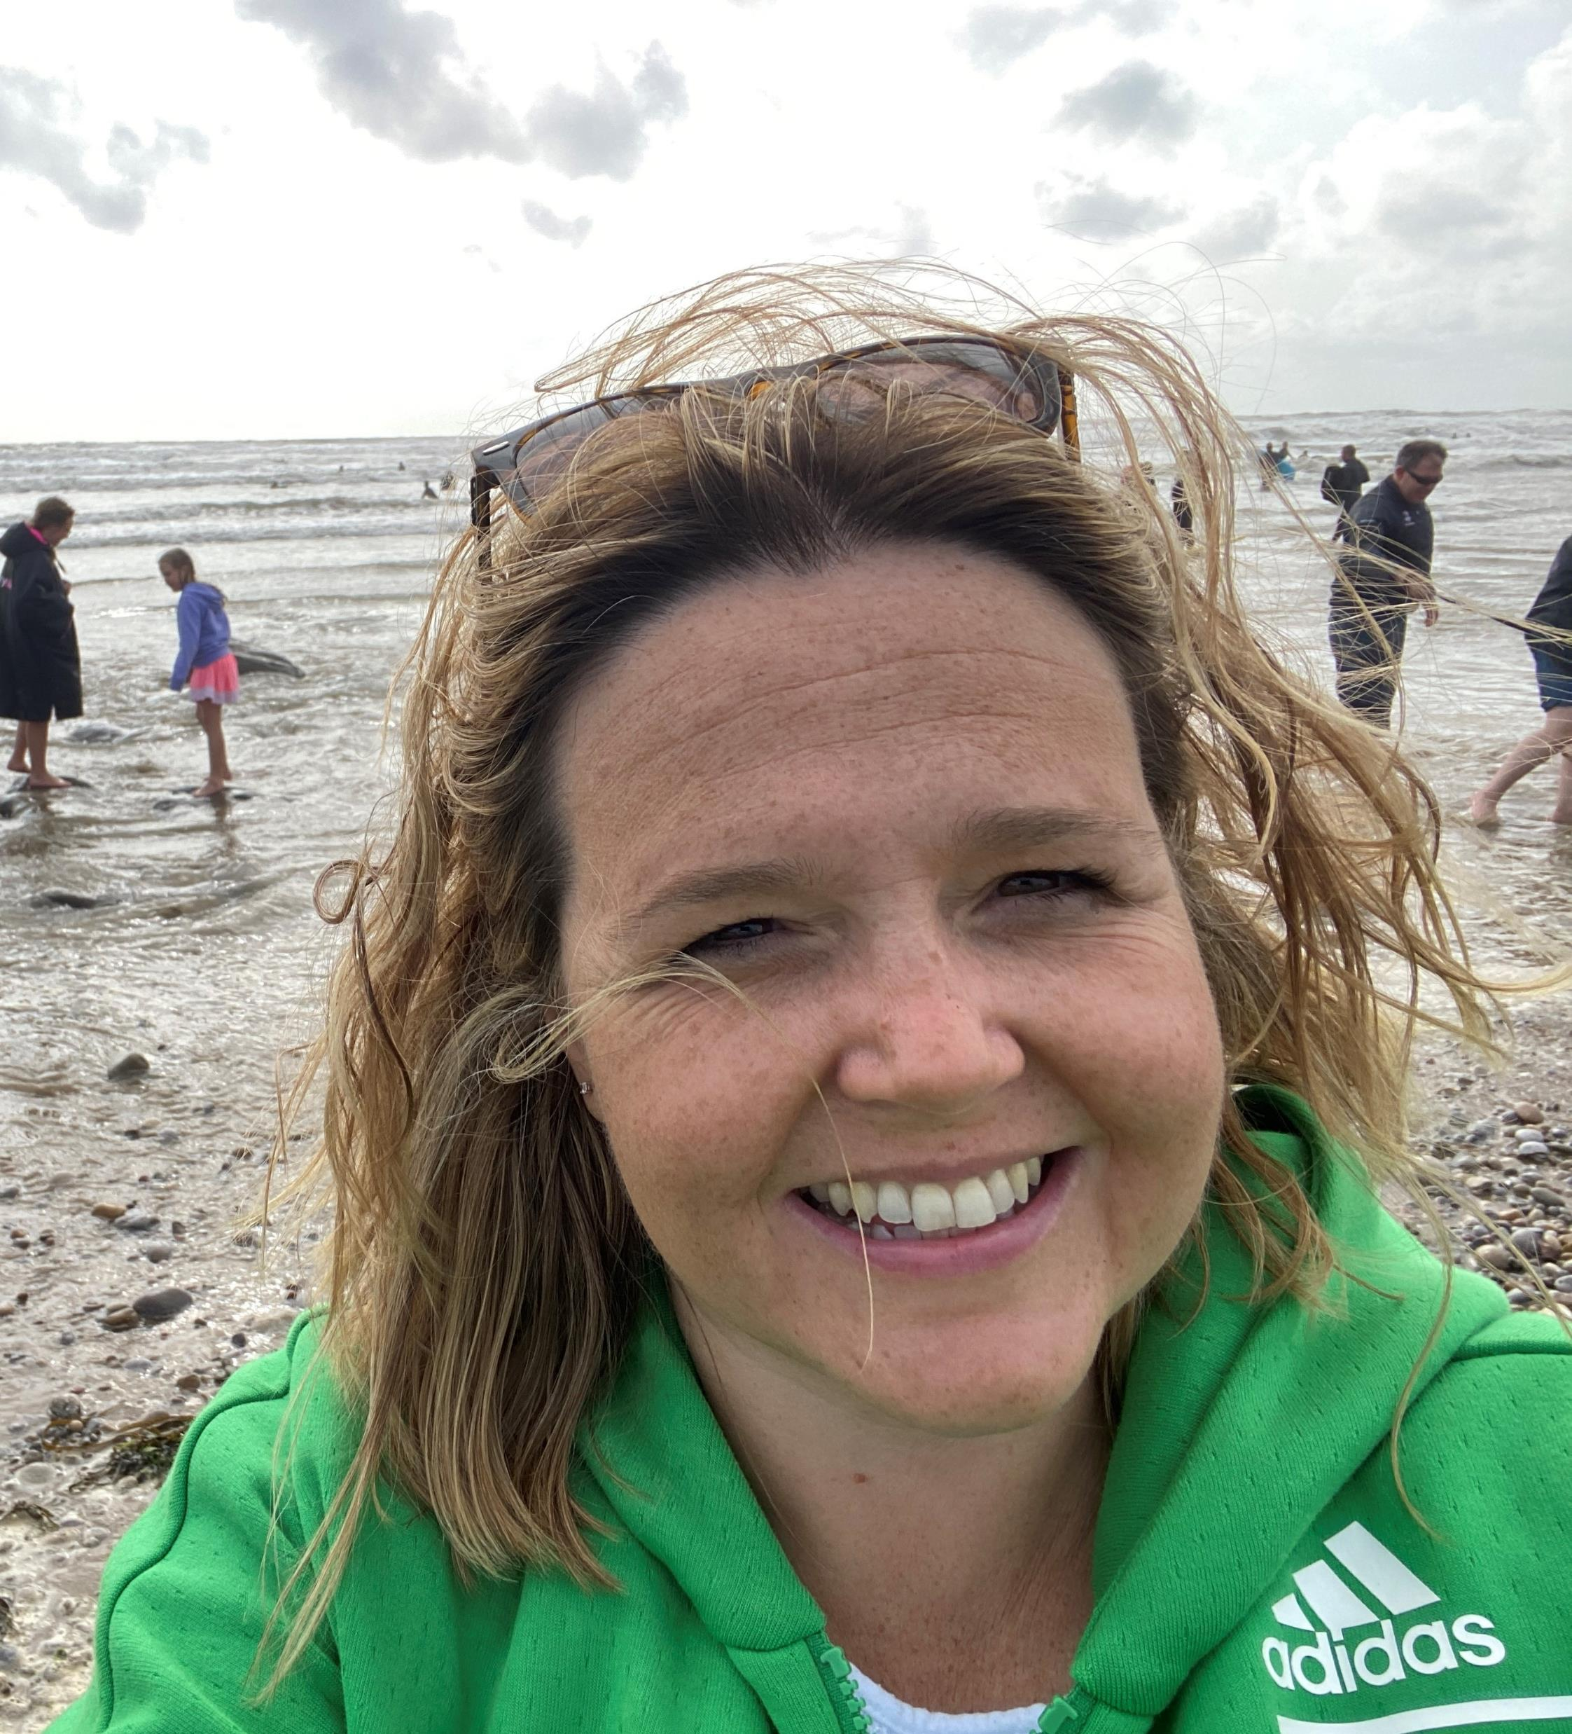

Tîm Ysgol Sylfaen Cymru Wales Foundation School Team
tîm ysgol sylfaen cymru
Dr Alison Ingham | Sioned Edwards | Dr Tom Yapp | Joanne Huish | Sarah Edwards
Deputy Foundation School Director | Executive officer | Foundation School Director | Foundation School Manager | Foundation Administrator

Slide 5
Partneriaeth Cydwasanaethau GIG Cymru (NWSSP) NHS Wales Shared Services Partnership (NWSSP)
Whilst HEIW and the Foundation School are responsible for your training, NWSSP will be your employer for the duration of your Foundation training. You can contact them directly via NWSSPSLE.Foundation@wales.nhs.uk if you have any employment related questions, such as;
Pay
Travel expenses
Contracts / proof of programme allocation
Banding queries and rotas (although these would usually be dealt with in conjunction with the LHB)

Slide 6
Cyfarwyddwyr Rhaglen Sylfaen (FPD) a Gweinyddwyr Sylfaen(FA) Foundation Programme Directors (FPD) and Foundation Administrators (FA)
In addition to the Foundation School team there are Foundation Programme Directors (FPDs) based in the hospitals across Wales, and each FPD is assisted by a Foundation Administrator. The FPD and FA can usually be found in the local postgraduate centre.
The FPDs responsibility is to ensure that a quality programme is being delivered and that each trainee doctor is adequately supervised throughout their training.
The FPD may also provide additional support if required.

Slide 7
Sefydlu Rhaglen Sylfaen (FPD) a Gweinyddwyr Sylfaen (FA) Foundation Programme Directors & administrators
Location | Foundation Programme Director | Foundation Administrator
Princess of Wales Hospital, Bridgend | Dr Gwylim McMillan | Anna Johnson / Claire Laidler
Morriston Hospital, Swansea | Dr Ritu Nirula | Ben Sillman / Sarah Morris
Singleton Hospital | Dr Rhodri Edwards | Bethany Jones
Royal Gwent / The Grange Hospital, Newport | Dr Ashok Vaghela | Caroline Newman
Nevill Hall Hospital, Abergavenny | Dr Helen Fowles
Glan Clwd Hospital, Rhyl, | Dr Lee Wisby | Elaine Hughes
Wrexham Maelor Hospital, Wrexham | Dr Artur Abelian | Kieran Owen
Ysbyty Gwynedd, Bangor | Dr Ushan Andrady | Myfanwy Roberts
University Hospital of Wales, Cardiff | Dr Karl Davis | Sharon Goodwin
University Hospital of Wales, Cardiff | Dr David Owens
Royal Glamorgan Hospital, Llantrisant | Dr David Samuel | Tania Williams
Prince Charles Hospital, Merthyr Tydfil | Dr Esyld Watson | Christine Hughes
Glangwili Hospital, Carmarthen | Dr Chris Horn | Kerry Rees / Rhiannon Taylor
Prince Philip Hospital, Llanelli | Dr Jonathan Morris
Bronglais General, Aberystwyth | Dr Yousaf Khan | Shelley Williams
Withybush General, Haverfordwest | Dr Antony Mathew | Louise Owen

Slide 8
Goruchwyliaeth Addysgol a Chlinigol Educational and Clinical Supervision
You will be assigned to an Educational Supervisor (ES) at the start of the F1 and F2 year. This person will remain your educational supervisor for the duration of the year, and they will also be your named clinical supervisor for your first 4-month placement. If you are on a GP LIFT programme, the GP you are assigned to will be your educational supervisor for the year.
When you move onto placements 2 and 3 you will be allocated to a new named Clinical Supervisor (nCS).
You will be expected to meet with your Educational supervisor at the beginning and end of your first 4-month placement and then at the end of placements 2 and 3, as a minimum. The meeting at the end of placement 3 will be to complete the end of year report.
Your Educational supervisor will liaise with your clinical supervisors throughout the year to review your progress and both will complete summative assessments in the form of Educational supervisor and Clinical supervisor reports.

Slide 9
Swyddfa Rhaglen Sylfaen y DU (UKFPO) Foundation Programme Office (UKFPO)
The UKFPO facilitates the operation and continuing development of the Foundation Programme; issues guidance on Foundation training and promotes consistent delivery across the UK. Along with managing the recruitment process to the Foundation Programme they are also responsible for the development and production of the UK Foundation Programme Curriculum.
For further information on the UK Foundation Programme office, please visit: https://foundationprogramme.nhs.uk

Slide 10
Cwricwlwm Sylfaen Foundation Curriculum
The UK Foundation Programme Office launched a new Curriculum for 2021. All F1 and F2 Doctors embarking on a new programme from August 2022 will follow the 2021 Curriculum.
An interactive copy of the Curriculum can be found on the UKFPO website.
In addition to the Curriculum a number of resources, including a series of YouTube videos, podcasts and factsheets have been produced by the UKFPO.
There is also ‘A Rough Guide to the Curriculum’ which summarises the new Curriculum.

Slide 11
Portffolio Dysgu Sylfaen (Turas) Foundation Learning Portfolio (Turas)
To assist you in recording evidence to satisfy the ARCP panel, you will use an electronic portfolio called TURAS.
TURAS can be accessed at: https://turasportfoliowales.nes.digital/ and you will receive an email with your login details so that you may access TURAS prior to commencement.
Should you experience any difficulties accessing or using the system, advice can be sought from your Foundation administrator.
Please remember, it is your responsibility to maintain and develop your Portfolio (TURAS), as a record of your professional development.

Slide 12
e-Ddysgu ar gyfer Gofal Iechyd (eLfH) e-Learning for Healthcare (eLfH)
In addition to TURAS you will also have access to the e-Learning for Healthcare portal. ELfH is a Health Education England Programme in partnership with the NHS and Professional Bodies providing high quality content free of charge for the training of the NHS workforce across the UK.
You will have been e-mailed your log in details for this directly from eLfH. The email used for the elfh account is the same email that was used to register with the GMC.
You can also register yourself at the following: http://portal.e-lfh.org.uk/register
Further information on this can be found using this link http://www.e-lfh.org.uk/home/
Should you have any queries about access to your e-learning account, please contact the helpdesk via
https://millennium.kayako.com/ES/Tickets/Submit

Slide 13
Adolygiad Blynyddol o Gynnydd Cymhwysedd(ARCP) Annual Review of Competence Progression (ARCP)
Towards the end of your F1 / F2 year, an ARCP panel will be convened, to review your progress. Further information regarding the ARCP process can be found on the UKFPO website
The ARCP Panels will be held in May / June, halfway through your 3rd post, so consequently, you will only have until the end of May to populate your e-portfolio with evidence for sign off. Your Educational supervisor will have to complete an end of year report prior to the ARCP panel.
If you are training “out of sync” (i.e. you will not be completing your F1 or F2 training in August) you will be given a U or N code by the original ARCP panel, and have a subsequent ARCP, at your transition point.

Slide 14
Rhestr Wirio ARCP The ARCP Checklist
Page 49 of the curriculum shows what is required
for successful sign off at the end of the training
period.
In addition, the Wales Foundation also requires:
Successful completion of Advanced Life Support (ALS)
A completed end of placement evaluation form (EPEF)
for each 4-month placement.

Slide 15
Ymgysylltu â'r rhaglen Engagement with the programme
For successful completion of your F1/F2 year you must demonstrate engagement with the programme, as follows:
Regular and appropriate engagement with the e-portfolio, including;
Consistently linking evidence to each of the 3 HLOs
Updating and maintaining the Summary Narrative for each HLO
Providing evidence of passing the PSA (F1 only)
Participation in feedback on training, through;
Completion of an End of Post Evaluation form for each 4-month placement.
Completion of the annual GMC survey
Meeting requirements for Revalidation;
Completion of a Form R at the end of your F1 and F2 year.

Slide 16
Asesu yn ystod Hyfforddiant Sylfaen Assessment during Foundation Training
The tools below will be used to inform your FPD, Educational and Clinical Supervisors of your progression. Each of these areas are described briefly in this document, but you are strongly advised to read the Curriculum for further information.
Pro-rata completion of SLEs to demonstrate learning;
Satisfactory attendance at delivered ‘core’ learning;
Satisfactory record of non-core learning;
Satisfactory reflection/summary narrative;
Attendance record;
Engagement with the programme, including maintenance of a contemporaneous e-portfolio, participation in feedback on training, and completing the necessary records for revalidation;
Placement supervision group assessment (PSG) in at least one placement at F1 and one at F2 (to be completed in placement 1).
Team assessment of behaviour (TAB) in at least one placement at F1 and one at F2 (to be completed in placement 2);

Slide 17
Digwyddiadau dysgu dan oruchwyliaeth (SLEs) Supervised learning Events (SLEs)
SLEs are used to provide a more formal way of recording feedback, and to allow it to be presented within the e-portfolio at ARCP, as evidence to support your progress against the curriculum. The following SLEs are used in the Foundation Programme:
Mini-CEX – mini clinical evaluation exercise: direct observation of the Foundation Doctor (FD) undertaking an interaction while at work on the ward;
CBD – case-based discussion: the discussion of a case presentation after an (unobserved) encounter in the workplace environment;
DCT – developing the clinical teacher: used for feedback on a formal teaching session or presentation the FD has delivered;
DOPS – direct observation of procedural skills: completion of which should, ideally, include observation of the explanation to the patient of why the procedure is being performed, the process of consent including an understanding of complications, and technical capability of the procedure itself;
LEARN – learning encounter and reflection note: a form for recording the above and other forms of evidence, such as performance in simulation;
LEADER – for recording feedback following an event where the FD has used leadership skills

Slide 18
Asesiad Tîm o Ymddygiad (TAB) Team Assessment of Behaviour (TAB)
TAB is the multi-source feedback tool that is used in the foundation programme. TAB comprises collated views from a range of multi-professional colleagues. It is mapped to the self-assessment tool with identical sections. The foundation doctor is responsible for organising TAB and should arrange this in a timely fashion.
The TAB assessment will be carried out towards the end of your second placements in both the F1 and the F2 year. A second TAB (in a following placement) may be required if problems are identified in the first assessment. The recommended timings for the TAB assessments are as follows:-
Trainees should carry out the TAB assessment in the second placement, however, there are instances when this may not be possible, due to the nature of the post. For example, there may not be a sufficient mix of assessors in a General Practice placement. Please liaise with your ES and FPD if you are unable to complete a TAB assessment in your second placement.
A satisfactory TAB is mandatory for completion of your training. If problems are identified in a TAB assessment, another will need to be carried out in the following placement.
For further details on the TAB assessment, please see the assessments section on the UKFPO website.
Placement | TAB created | Response Submission deadline
Placement 2 (expected) | 2nd week of February | End of February
Placement 3 (if required) | 2nd week of April | End of April

Slide 19
Grŵp Goruchwylio Lleoliadau (PSG) Placement Supervision Group (PSG)
Your named Clinical supervisor in your first F1/F2 placement will identify a group of senior healthcare professionals who will work alongside you to make up a ‘Placement Supervision Group’.
The purpose of the PSG is to provide constructive senior feedback on your performance. One satisfactory PSG is required for sign off at the end of the F1/F2 year.
Further information on the make up and role of the Placement Supervision Group can be found in the Curriculum.
A satisfactory PSG is required for completion of your training. If problems are identified within the PSG report, another will need to be carried out in the following placement.

Slide 20
Dysgu creiddiol a dysgu nad yw'n greiddiol Core & non core learning
Core Foundation learning sessions will be delivered by your local Foundation Team, and you will be informed of these sessions once you commence the Foundation Programme.
You are required to log 60 hours of learning at each level of training, of which up to 30 hours can be ‘non-core learning’.
You will be expected to take part in other learning activities including non-core learning and self-directed learning and will be required to log this in your portfolio.
F2s will receive sessions in the form of F2 study days, further information regarding these will be provided by your local Postgraduate Centre.
Examples of non-core learning activities can be found in the Curriculum.

Slide 21
Amser hunanddatblygu (SDT) Self-development time (SDT)
All foundation doctors in Wales will be expected to have Self-Development Time within their work schedules. SDT should be used for non-clinical activities that allow you to develop – for example, preparing/delivering teaching, quality improvement activity, career exploration, decision making and applications.
Self-development time will largely be self-directed but may be instigated at the suggestion of your ES or CS, or as the result of feedback. It may involve enhancing knowledge and exploring areas of interest. This sort of activity should be recorded in the e-portfolio as ‘non-core’ learning, mapped against the areas of the curriculum, with suitable evidence of learning through reflection.
It is expected that SDT will be undertaken in the clinical setting. It is not intended to replace time already available in work schedules to carry out other non-clinical activities such as study leave, attending departmental meetings etc.

Slide 22
Amser hunanddatblygu (parhad) Self development time (continued)
F1 doctors will be given 1 hour per week
F2 doctors will be given 3 hours per week
LTFT trainees will carry out SDT on a pro-rata basis.
Please note: SDT can be taken per week or delivered in a block e.g. F1s may wish to take 4 hours once a month. This will be at the discretion of the Educational Supervisor, who will be responsible for timetabling SDT into your training schedule (though this can also be delegated to a Named Clinical Supervisor) and will be arranged during your supervisor meetings.
There is an expectation that the commitment to SDT will be met by the local health boards but there may be times when other duties take precedence.
Please notify your local foundation team or the Wales Foundation School if SDT is regularly unavailable or denied. We do not envisage that any SDT missed due to leave will be “rolled over” into following weeks.

Slide 23
Myfyrdod Boddhaol/ Naratif Cryno Satisfactory Reflection/ Summary Narrative
The Foundation Programme endorses the importance of reflection by Foundation Doctors as a means of enhancing learning and improving the care they provide to their patients. Reflection can be carried out in a number of ways and some evidence of this should be recorded in the e-portfolio. Further advice on reflection can be found on the UKFPO website.
The summary narrative is a form of written reflection that will help you to demonstrate to your Educational Supervisor that you have achieved the Curriculum requirements.
At the completion of each level of training, prior to the final meeting with the ES, you will be required to complete a written summary of your progress against each higher learning outcome (HLO). This should be a maximum of 300 words, and should reference evidence to support your progress, or achievement, against the Foundation Programme Capabilities. This is a working document that should be added to through the year.
Detailed guidance on how to write the summary narrative is available in the appendix of the Curriculum.

Slide 24
Asesiad Diogelwch Rhagnodi (PSA) Prescribing Safety Assessment (PSA)
F1 Doctors must provide evidence that they have passed the PSA within two years prior to entry to the programme or on completion of the programme.
If you have not already completed the PSA, the Foundation School will be in touch to inform you of the arrangements.
The first assessment will be held between 13:00 and 15:00 on Tuesday 6th September 2022

Slide 25
Absenoldeb o Hyfforddiant Absence from Training
The Foundation Programme is both time and competency-based and any absence*, other than annual and study leave needs to be recorded. When a doctor’s absence goes above 20 days, this will trigger a review of whether they need to have an extra period of training (see GMC position statement on absences).
*The absence includes all forms of absence, such as sickness, maternity, compassionate paid/unpaid leave, other than study leave (including taster weeks) or annual leave.
All absences should be recorded in your e-portfolio account throughout the year. Should you go over the 20 days then you will need to ensure that you have informed your Foundation Programme Director, Postgraduate Centre and the Wales Foundation School.
The GMC guidance on this can be found on the GMC website.

Slide 26
Hyfforddiant Llai na Llawn Amser (LTFT) Less than Full Time Training (LTFT)
Information on Less than Full Time Training can be found on the HEIW website. Please note that if you chose to work on a Less than full time basis it will take longer than two years to complete the Foundation Programme.

