Slide 1
Canllaw i Feddygon Sylfaen sy’n Dechrau ym mis Awst 2024
A Guide for Foundation Doctors Commencing August 2024

Slide 2
Croeso Welcome
We aim to ensure that you enjoy your time as a Foundation Doctor with the Wales Foundation School and have written this guide so you are aware of what you can expect and what is expected of you as a Foundation Doctor. This guide contains just some of the key information that you will need throughout your Foundation training. In addition to the guide, the Wales Foundation school will send monthly email bulletins and other updates.
Your local Foundation Programme Director (FPD) and administrator will provide you with key local information throughout the Programme, but should you have any queries, the team in the Wales Foundation School are only too happy to help. In the first instance please visit our website:- https://heiw.nhs.wales/education-and-training/foundation/
If you are unable to find the answer on our website, please contact HEIW.FoundationSchool@wales.nhs.uk

Slide 3
Pobl hollbwysig Key people
UK Foundation Programme Office (UKFPO)
Wales Foundation School – part of Health Education Improvement Wales (HEIW)
NHS Wales Shared Services Partnership (NWSSP) – the Single Lead Employer
Foundation Programme Directors and local Foundation Administrators – within your "host organisation"
Educational and Clinical Supervisors – linked to your allocated placements

Slide 4
Swyddfa Rhaglen Sylfaen y DU (UKFPO)
Foundation Programme Office (UKFPO)
The UKFPO facilitates the operation and continuing development of the Foundation Programme; Issues guidance on Foundation training and promotes consistent delivery across the UK. Along with managing the recruitment process to the Foundation Programme they are also responsible for the development and production of the UK Foundation Programme Curriculum.
For further information on the UK Foundation Programme office, please visit: https://foundationprogramme.nhs.uk

Slide 5
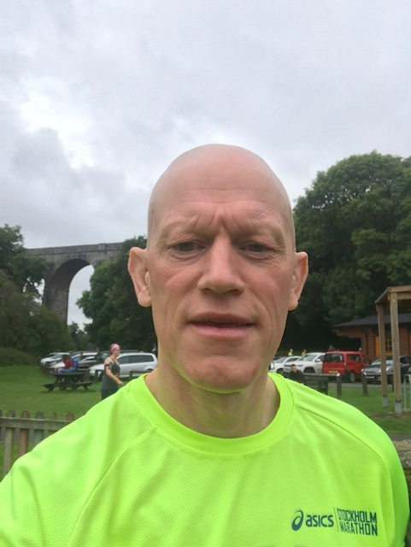
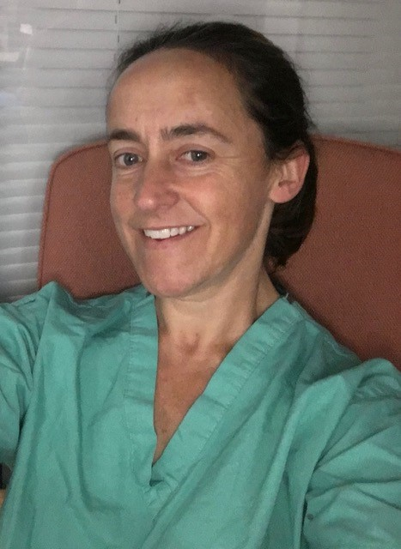
Tîm Ysgol Sylfaen Cymru
Wales Foundation School Team
Prof Tom Yapp | Dr Alison Ingham
Foundation School Director | Deputy Foundation School Director
Consultant Gastroenterologist, Princess of Wales Hospital | Consultant Anesthetist, Ysbyty Gwynedd

Slide 6
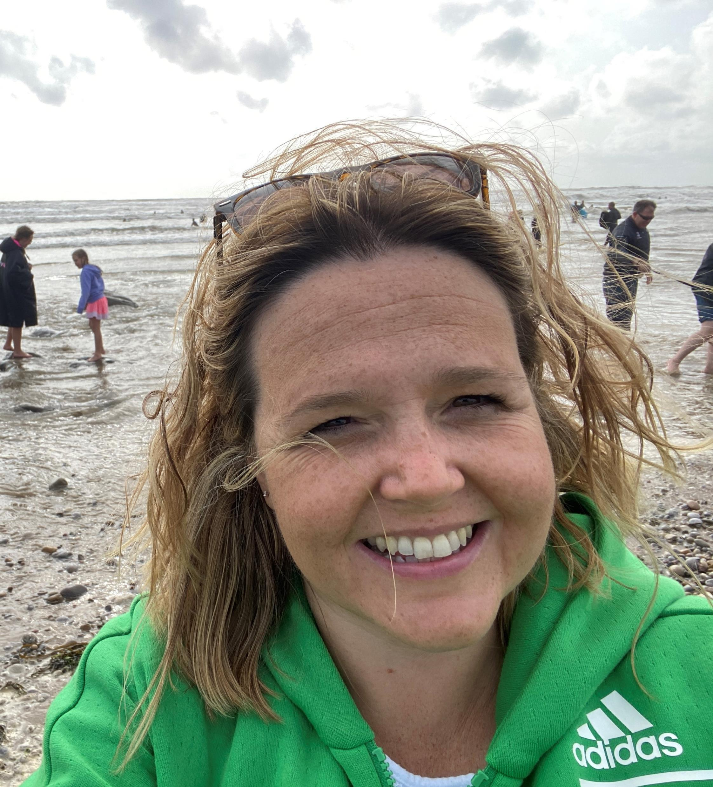
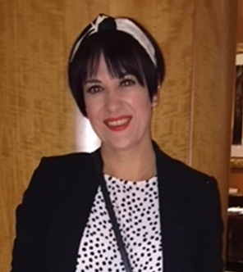
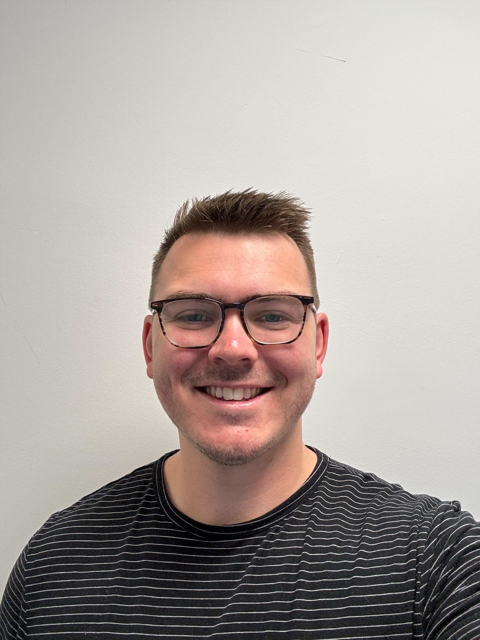
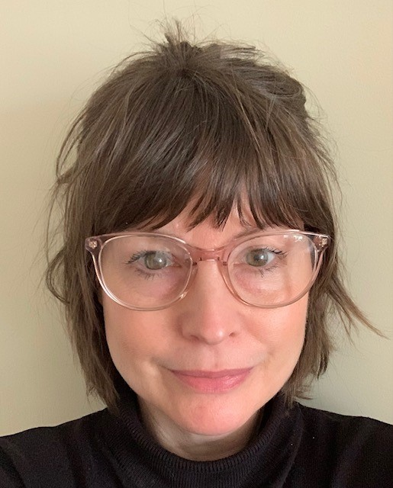
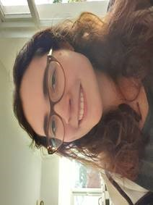
Tîm Ysgol Sylfaen Cymru
Wales Foundation School Team
Joanne Huish | Sioned Edwards | Sarah Edwards | Thomas Hunt | Joanne Mason
Foundation School Manager | Foundation Manager (Trainee Progression) | Foundation Manager (Programme Management) | Administrative Officer (Trainee Progression) | Administrative Officer (Programme Management)
Contact us via HEIW.FoundationSchool@wales.nhs.uk

Slide 7
Partneriaeth Cydwasanaethau GIG Cymru (NWSSP)
NHS Wales Shared Services Partnership (NWSSP)
NWSSP will be your employer for the duration of your Foundation training.
You can contact them directly via NWSSPSLE.Foundation@wales.nhs.uk if you have any employment related questions, such as:
Pay
Travel expenses
Contracts / proof of programme allocation
Banding queries and rotas (although these are dealt with in conjunction with the host organization e.g. Hospital or Health Board)

Slide 8
Cyfarwyddwyr Rhaglen Sylfaen (FPD) a Gweinyddwyr Sylfaen(FA)
Foundation Programme Directors (FPD) and Foundation Administrators (FA)
In addition to the Foundation School team, there are Foundation Programme Directors (FPDs) based in the hospitals across Wales, and each FPD is assisted by a local Foundation Administrator (FA). Contact details have been provided within your "Welcome to Wales" email from the Foundation School.
The FPDs' responsibility is to ensure that a quality programme is being delivered within their region and that each trainee doctor is adequately supervised throughout their training.
The FPD may also provide additional support if required.

Slide 9
Sefydlu Rhaglen Sylfaen (FPD) a Gweinyddwyr Sylfaen (FA)
Foundation Programme Directors & administrators
Region | Hospital | FPD | FA
Betsi Cadwaladr UHB (West) | Ysbyty Gwynedd, Bangor | Dr Ushan Andrady | Angela Charlton
Betsi Cadwaladr UHB (Central) | Ysbyty Glan Clwyd, Rhyl | Dr Eve Blakemore | Elaine Hughes
Betsi Cadwaladr UHB (East) | Wrexham Maelor, Wrexham | Dr Artur Abelian | Gemma Lewis
Hywel Dda UHB (Cered.) | Bronglais Hospital, Aberystwyth | Mr Simone Sebastiani | Shelley Williams
Hywel Dda UHB (Pembs.) | Withybush Hospital, Haverfordwest | Dr Antony Mathew | Louise Owen
Hywel Dda UHB (Carms.) | Glangwili General Hospital, Carmarthen Prince Philip Hospital, Llanelli | Dr Jo McCarthy / Dr Jon Morris Dr Adam Tyler | Rhiannon Taylor Kerry Rees
Swansea Bay UHB | Morriston Hospital, Swansea Singleton Hospital, Swansea | Dr Ritu Nirula Dr Rhodri Edwards | Bethany Jones Sydney Lewis
Cardiff & Vale UHB | University Hospital Wales, Cardiff | Dr Rachel Rayment Dr David Owens | Sharon Goodwin
Cwm Taf Morgannwg UHB (West) | Princess of Wales Hospital, Bridgend | Dr Gwilym McMillan | Claire Laidler
Cwm Taf Morgannwg UHB (North) | Prince Charles Hospital, Merthyr Tydfil | Dr Esyld Watson | Donna Morgan
Cwm Taf Morgannwg UHB (South) | Royal Glamorgan Hospital, Pontyclun | Mr Sam Fishpool | Sarah Bechares
Aneurin Bevan UHB | Royal Gwent Hospital, Newport Nevill Hall Hospital, Abergavenny | Dr Ashok Vaghela Dr Helen Fowles Dr Jennifer Rankin | Sophie Miller

Slide 10
Goruchwyliaeth Addysgol a Chlinigol
Educational and Clinical Supervision
You will be assigned to an Educational Supervisor (ES) at the start of your F1 and F2 year, which will be for the duration of that year.
For most programmes, your ES will also be your Clinical Supervisor (CS) for your first 4 month placement, however for GP LIFT programmes, your GP Supervisor will be your ES.
For each of your placements (including any LIFT placements) you will also have a named Clinical Supervisor.
You should meet with your Educational supervisor at the beginning of the year, then at the end of each placement, as a minimum. The meeting towards the end of your final placement of the year will be to complete the end of year report ready for ARCP. This should be done in May for the June ARCPs.
Your Educational supervisor will liaise with your clinical supervisors throughout the year to review your progress and both will complete summative assessments in the form of Educational supervisor and Clinical supervisor reports.

Slide 11
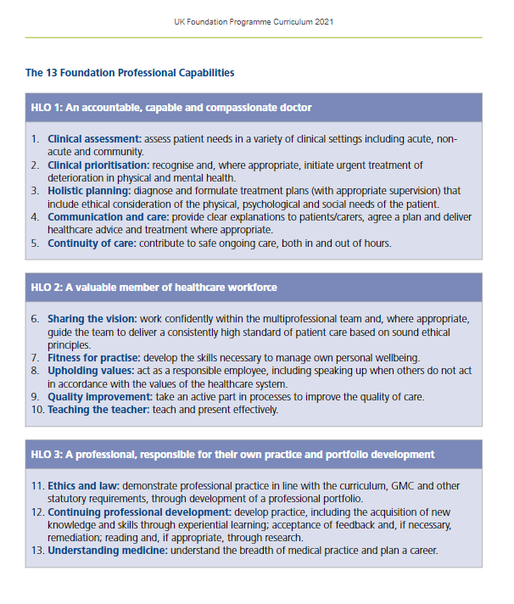
Cwricwlwm Sylfaen
Foundation Curriculum
All Foundation Doctors will follow the 2021 Foundation Curriculum. The curriculum is made up of 3 Higher Learning Outcomes (HLOs), which must be demonstrated by meeting each of the 13 Foundation Professional Capabilities (FPCs).
An interactive copy of the Curriculum can be found on the UKFPO website.
In addition to the Curriculum a number of resources, including a series of YouTube videos, podcasts and factsheets can be found on the UKFPO website.

Slide 12
eBortffolio Dysgu Sylfaen (Turas)
Foundation Learning ePortfolio (Turas)
To record evidence to satisfy the ARCP panel, you will use an electronic portfolio called Turas.
Turas can be accessed at: https://turasportfoliowales.nes.digital/ and you should have already received an email with your login details so that you may access your account prior to commencement.
There is also some guidance available on the Scotland Foundation School website.
Should you experience any difficulties accessing or using the system, advice can be sought from your local Foundation administrator in the first instance.
Please remember, it is your responsibility to maintain and develop your ePortfolio as a record of your professional development.

Slide 13
e-Ddysgu ar gyfer Gofal Iechyd (eLfH) e-Learning for Healthcare (eLfH)
In addition to Turas, you will also have access to the e-Learning for Healthcare (eLfH) portal.
eLfH is a Health Education England Programme in partnership with the NHS and Professional Bodies providing high quality content free of charge for the training of the NHS workforce across the UK.
You will have been e-mailed your log in details for this directly from eLfH. The email used for the eLfh account is the same email that was used to register with the GMC.
You can also register yourself at the following: http://portal.e-lfh.org.uk/register
Further information on this can be found using this link http://www.e-lfh.org.uk/home/
Should you have any queries about access to your e-learning account, please contact the helpdesk via https://support.e-lfh.org.uk/

Slide 14
Amser hunanddatblygu (SDT)
Self-development time (SDT)
This is time included within your job plan that should be used for non-clinical activities required to develop as a Foundation Doctor. Examples of this would be;
Preparing or Delivering teaching
Non-Core Learning
Quality Improvement activity
Career exploration or research
Applications
Supervisor meetings or updating your ePortfolio
Foundation Year | SDT per week
F1 | 1 hour
F2 | 3 hours
Pro-rata for LTFT trainees

Slide 15
Amser hunanddatblygu (parhad)
Self development time (continued)
This time is self-directed; however, areas of focus may be suggested by your supervisors and all SDT should take placed within the clinical setting. This time is not intended to replace time already available in schedules for non-clinical work, such as Study Leave or departmental meetings.
There is an expectation that the commitment to SDT will be met by the local health boards but there may be times when other duties take precedence.
SDT can be consolidated with the approval of your supervisor (e.g. an F1 taking 4 hours per month).
However, it is not envisaged that SDT missed due to annual leave or study leave will be carried forward.

Slide 16
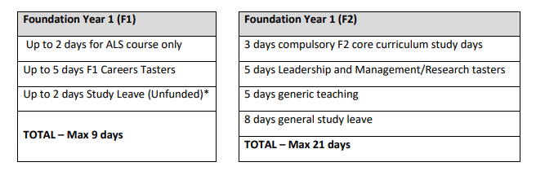
Absenoldeb Astudio
Study Leave
Study Budget Entitlement:
£250 for specialised F1s
£480 for F2s
The Study Leave entitlement is split between your F1 and F2 year, with recommendations for what the leave can be used for.
Please note in F1 your ALS course will be arranged for you, and in F2 the Study Days and Generic Teaching will also be pre-determined.
All other leave can be taken at the approval of your supervisor; however we ask that the days are spread equally across placements when possible

Slide 17
Adolygiad Blynyddol o Gynnydd Cymhwysedd(ARCP) Annual Review of Competence Progression (ARCP)
Towards the end of your F1 / F2 year, an ARCP panel will be convened, to review your progress. Details of the ARCP process can be found on the UKFPO website.
The main ARCP Panels will be held in June, so you will only have until the end of May (partway through your 3rd placement) to populate your ePortfolio with evidence to meet the requirements for sign off.
If you are training “out of sync” (i.e. you will not be completing your F1 or F2 training in August) you will be given a “No Review” code by the June ARCP panel and have a subsequent ARCP at your transition point. Ad hoc information will be provided for those impacted.

Slide 18
Rhestr Wirio ARCP
The ARCP Checklist
Page 49 of the curriculum shows what is required for successful sign off at the end of the training period.
In addition, the Wales Foundation Programme also requires:
Successful completion of Advanced Life Support (ALS) in F1
A completed end of placement evaluation form (EPEF) for each 4-month placement.

Slide 19
Asesu yn ystod Hyfforddiant Sylfaen
Assessment during Foundation Training
The tools below will be used to inform your FPD, Educational and Clinical Supervisors of your progression and aid the completion of your placement reports. Each of these areas are described briefly in this document, but you are strongly advised to read the Curriculum or watch the UKFPO’s video for further information.
Attendance record;
Multi-Source Feedback (in the form of a PSG and TAB)
Regular completion of SLEs to demonstrate learning;
Regular reflections/completion of the summary narrative;
Satisfactory attendance at delivered ‘core’ learning and ‘non-core’ learning record;
Engagement with the programme (i.e. maintenance of a contemporaneous e-portfolio, participation in feedback on training, and completing the necessary records for revalidation);
Passing the required qualifications (i.e. PSA and ALS for F1)

Slide 20
Absenoldeb o Hyfforddiant
Absence from Training
The Foundation Programme is both time and competency-based and any absence*, other than annual and study leave needs to be recorded. When a doctor’s absence goes above 20 working days, this will trigger a review of whether they need to have an extra period of training (see GMC position statement on absences).
*Such as sickness, maternity, compassionate paid/unpaid leave.
All absences should be recorded in your e-portfolio account throughout the year. Please ensure that you inform NWSSP and your local Foundation administrator of any absences, as well as following as departmental absence reporting procedures.
The GMC guidance on this can be found on the GMC website.

Slide 21
Hyfforddiant Llai na Llawn Amser (LTFT)
Less than Full Time Training (LTFT)
Information on Less than Full Time Training can be found on the HEIW website.
Please note that if you chose to work on a Less than full time basis your Foundation Programme will be extended accordingly.

Slide 22
Grŵp Goruchwylio Lleoliadau (PSG)
Placement Supervision Group (PSG)
We recommend that this is completed in your first F1 or F2 placement.
Your named Clinical supervisor will identify a group of senior healthcare professionals to make up a ‘Placement Supervision Group’ as part of your initial meeting and will then send out feedback requests towards the end of the placement.
The purpose of the PSG is to provide constructive senior feedback on your performance, which will be rated as Satisfactory or Unsatisfactory by your supervisor.
Further information on the make up and role of the Placement Supervision Group can be found in the Curriculum.
A satisfactory PSG is required for completion of your training. If problems are identified within the PSG report, another will need to be carried out in a following placement.

Slide 23
Asesiad Tîm o Ymddygiad (TAB)
Team Assessment of Behaviour (TAB)
We recommend that this is completed in your second F1 or F2 placement, although some placements may struggle to obtain the required split of respondents so confirm whether this should be varied for your rotation with your Educational and Clinical Supervisor.
Feedback should be requested by you via the ePortfolio and a self-assessment also completed. This is then reviewed and rated Satisfactory or Unsatisfactory by your supervisor.
It is recommended that a TAB is completed after 10 weeks of your placement start (for your 3rd placement this will result in an Outcome 5 due to the timing of the ARCPs);
Further information on the TAB can be found on the UKFPO website.
Placement | TAB created | Response Submission deadline
Placement 1 (if required) | 2nd week of October | End of October
Placement 2 (expected) | 2nd week of February | End of February
Placement 3 (if required) | 2nd week of June | End of June

Slide 24
Digwyddiadau dysgu dan oruchwyliaeth (SLEs)
Supervised learning Events (SLEs)
SLEs are used to provide a more formal way of recording feedback, and to allow it to be presented within the e-portfolio at ARCP, as evidence to support your progress against the curriculum. The following SLEs are used in the Foundation Programme:
Mini-CEX – mini clinical evaluation exercise: direct observation of the Foundation Doctor (FD) undertaking an interaction while at work on the ward;
CBD – case-based discussion: the discussion of a case presentation after an (unobserved) encounter in the workplace environment;
DCT – developing the clinical teacher: used for feedback on a formal teaching session or presentation the FD has delivered;
DOPS – direct observation of procedural skills: completion of which should, ideally, include observation of the explanation to the patient of why the procedure is being performed, the process of consent including an understanding of complications, and technical capability of the procedure itself;
LEARN – learning encounter and reflection note: a form for recording the above and other forms of evidence, such as performance in simulation;
LEADER – for recording feedback following an event where the FD has used leadership skills

Slide 25
Myfyrdod Boddhaol/ Naratif Cryno
Satisfactory Reflection/ Summary Narrative
Reflection forms can also be created by you to demonstrate your achievements or self improvement and can be mapped to specific HLOs on the Curriculum. These are set as private on your ePortfolio until they are shared with your supervisors.
The Summary Narrative is another form of written reflection intended to assist your Educational Supervisor (and eventually the ARCP panel) in identifying your progress and achievements.
This should be initiated towards the end of your 1st placement and updated towards the end of each placement until your ARCP. There is a 300 word limit for each HLO.
More information on Curriculum Mapping and the Summary Narrative can be found on the UKFPO’s website.

Slide 26
Dysgu creiddiol a dysgu nad yw'n greiddiol
Core & Non Core learning
Core learning sessions will be delivered by your local Foundation Team, and you will be informed of these sessions once you commence the Foundation Programme. These will be in the form generic teaching in F1 and Study Days in F2.
Core Learning should make up at least 30 hours of your combined learning for the year.
You will also be expected to take part in other Foundation relevant learning activities (including self-directed learning), which should bring your total learning log up to 60 hours.
All learning should be logged in your ePortfolio.
Details of the learning categories (and exclusions) can be found on the UKFPO’s website.

Slide 27
Ymgysylltu â'r rhaglen
Engagement with the programme
For successful completion of your F1/F2 year you must demonstrate engagement with the programme, through the following:
Regular and appropriate engagement with the ePortfolio
Participation in feedback on training, through;
  Completion of an End of Placement Evaluation Forms (EPEFs) for each 4-month placement (these forms can be found on the ePortfolio)
  Completion of the annual GMC survey (in March each year)
Meeting requirements for Revalidation;
  Completion of a Form R in preparation for your ARCP.

Slide 28
Asesiad Diogelwch Rhagnodi (PSA)
Prescribing Safety Assessment (PSA)
F1s only
If you have passed the PSA in the 2 years prior to starting the Foundation Programme, this will be uploaded to Turas in bulk in August. You will then be able to upload your certificate in preparation for your ARCP.
If you need to sit or resit the PSA, the Foundation School will be in touch with the arrangements of these sittings.
The first assessment will be held on Tuesday 10th September 2024.

Slide 29
Cymorth Bywyd Uwch (ALS)
Advanced Life Support (ALS)
F1s only
One sitting of the ALS course will be funded by the Foundation School for each doctor.
Please refer to our ALS Course Funding Policy for further information.
The courses are held locally and will be arranged by your local Postgraduate Centre.
If you do not successfully complete this course, you will need to fund any subsequent resits yourself.

