Slide 1

DFT National Recruitment Process – Welsh Update
David Hannington
Associate Dental Foundation Training in Wales
WELCOME
RECORDING

Slide 2

Who we are
Health Education and Improvement Wales (HEIW) have a leading role in the education, training, development and shaping of the healthcare workforce in Wales. Ensuring we have the right staff, with the right skills, to deliver world-class healthcare to the people of Wales both now and in the future.
Established in 2018 as a Special Health Authority we sit alongside health boards and trusts as part of NHS Wales.
The Dental Postgraduate section of Health Education and Improvement Wales (HEIW) supports postgraduate education and training for the whole dental workforce (dentists and dental care professionals) in Wales.
This includes Dental Foundation, Dental Core and Dental Specialty Training for dentists and Continuing Professional Development (CPD) for dentists and dental care professionals (DCP).

Slide 3
Dental Foundation Training in Wales
Dental Foundation Training is the first phase of continuing postgraduate education after graduation and is recognised as a part of career pathways in all sections of the dental profession.
Gateway to NHS Performers List
Graduates join as salaried performers in approved practices with General Dental Practitioners who have been appointed as Educational Supervisors. During the three academic terms, the Foundation Dentists attend an educational day release programme designed to educate them in both the clinical and the administrative aspects of NHS dentistry.
In Wales we are part of a Single Lead Employer arrangement. This means that NHS Wales Shared Service Partnership (NWSSP) will be the employer for the Dental Foundation Training year.

Slide 4
Director of Dental Postgraduate Education in Wales
Associate Dean, Dental Foundation Training
North Wales Training Programme Director
Business Manager
Cardiff & Barry Training Programme Director
Newport & East Wales Training Programme Director
Swansea & West Wales Training programme Director
Glamorgan Vale & Beacons Training Programme Director
Swansea Vale Training Programme Director
DFT Administrator
DFT Administrator
DFT Administrator
DFT Administrator
DFT Administrator
Educational supervisors x10
Educational Supervisors x11
Educational Supervisors x11
Educational Supervisors x9
DFT Administrator
Educational Supervisors x10
Educational Supervisors x11
Dental Foundation Training Manager
Record of Competency Progression Administrator
DFT structure within HEIW

Slide 5
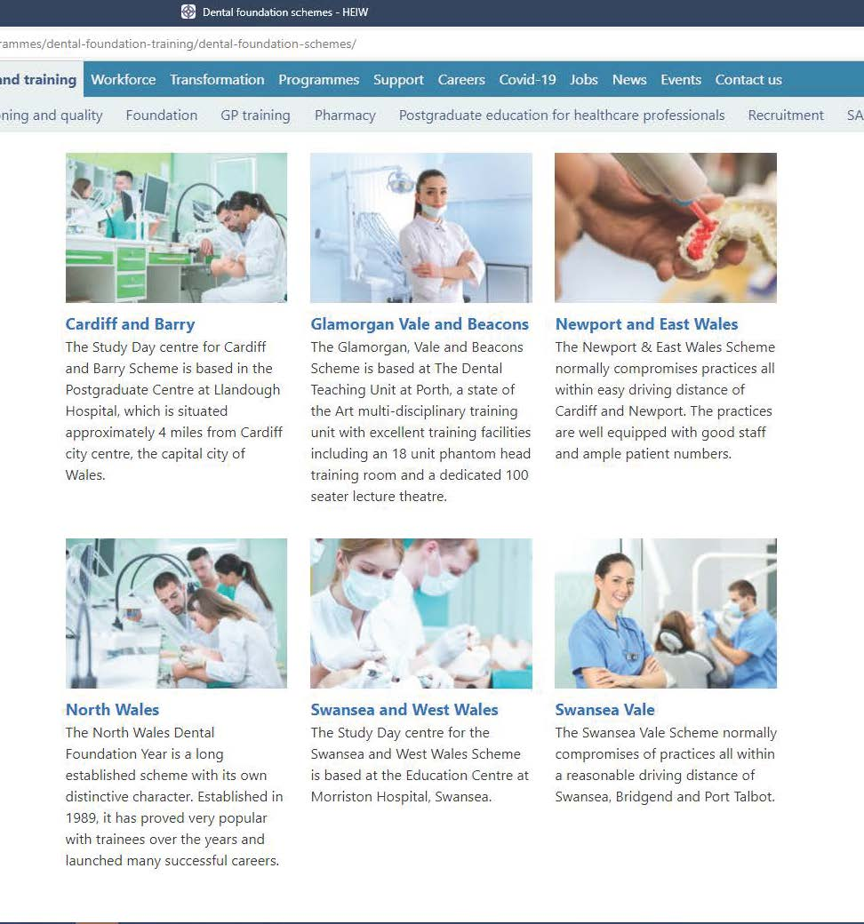

Slide 6
What Wales can offer during your DFT year
Contract reform
Single Lead Employer package
A range of Quality training practices with experienced Educational Supervisors
Posts within a Dental Training Unit
Very experienced, supportive Training Programme Directors
Small scheme sizes
Our programmes include 30 study days per year. Currently operating a blended learning approach with experienced top class speakers.
Quality Improvement training – such as Designed to Smile, MPWiP

Slide 7
Dental Training Unit Porth
The Glamorgan, Vale and Beacons Scheme is based at The Dental Teaching Unit at Porth, a state of the art multi-disciplinary training unit with excellent training facilities including an 18 unit phantom head training room and a dedicated 100 seat lecture theatre.
The Unit is a short walking distance from Porth train station (catch the Valley’s line train to Treherbert, approximately every 30 minutes, which is only a 40 minute journey from Cardiff Central station)

Slide 8
Dental Training Unit Port Talbot
Port Talbot Resource Centre (PTRC) is 15 minutes from Swansea.
PTRC houses GP surgeries, physiotherapy and podiatry services, as well as many other primary care facilities including our Dental Teaching Unit.
Our Unit has six individual (enclosed) surgeries boasting contemporary equipment and materials.
The Unit is fully computerised with digital intra-oral and OPT radiography as well as a fully equipped decontamination facility and a seminar room.
On the upper floor of the PTRC there is a 6 unit Phantom Head room and access to a lecture theatre and excellent staff facilities.
Swansea and West and Swansea Vale schemes

Slide 9
National Recruitment Process 2021
Preferencing window opens on the 17th June - 1st July. During this time you will be preferencing all the practices in the DFT pot.
National Recruitment will make available a practice profile to help you with preferencing. However we also intend to upload to our HEIW website - a map of our Welsh schemes, and the practice webpage (if available). Also available on our HEIW website are FD testimonials of past FDs who can offer some insight into their time on each scheme and a scheme template which gives a bit more information about each Welsh scheme.
We appreciate that preferencing local/central practices high is tempting. Please remember that whilst they are a bit further afield, our rural practices offer excellent training and an opportunity to experience life in the welsh countryside. In addition to their amazing locations, these practices can often offer an enhanced level of training due to the broad range of patients that you will experience.
https://heiw.nhs.wales/education-and-training/dental/training-programmes/dental-foundation-training/dental-foundation-schemes/

Slide 10
National Recruitment Process 2021
Preference any practices in areas you are prepared to work in.
Use filters to select all practices in a particular area.
“Drag and drop” to order practices according to preference for a region.
15th July Conditional offers will be issued.
These need to be accepted within 48 hours as a “firm acceptance” or “accepted with upgrades”
Further practices may be added up to 29th July if numbers graduating warrant this.
Those candidates who are unable to start in Sept 2021 be removed from cohort 1 and will have their offers recycled to applicants in cohort 1
Friday August 6th, regions informed of allocations

Slide 11
Challenges 2021
Study day programme-social distancing
Return to “Green Phase” working ??
Patient Backlog
Remote consultations
Onboarding/transition to Practice.
Late start implications.

Slide 12
National Recruitment process 2021
All trainees will receive a welcome email and FAQs on 6th August confirming details about NWSSP, Pre-employment checks (PECs) ESR & expenses details, annual leave etc.
Pre-employment checks to be carried out on 10th + 11th August in All Nations Centre, Cardiff and 10th August in North Wales.
Ensure you are available
All trainees must attend one of the above PEC checks and bring all documents in order to commence post on 1st September 2021, failure to do this may result in start date being delayed.

Slide 13
National Recruitment process 2021 ctd
Documents to be checked in person are as follows: (Originals only) ALL documents must be brought to PEC meeting
1.GDC Registration with a License to Practice
2. Proof of Right to Work in the UK (Passport, Biometric Residency Permit, etc.)
3. Proof of ID (Driving License) NOTE: This must be different to your Proof of RTW document
4. Proof of Address (Utility bill, bank statement etc.)
5. Proof of Dental Qualification (Degree Certificate, etc.)
If the Certificate is delayed from the University prior to your PEC meeting please bring evidence confirming you have passed the qualification (email is sufficient) Degree will need to be seen in person and can be presented to host organisation on day one of employment.
6. Proof of Disclosure & Barring Service (DBS) Certification, or confirmation that you do not have a current DBS certificate. If you do not have a current DBS we will provide you with access to commence this process on the day of your PEC.
7. Please note we will also require full OH clearance including EPP. (OH form will be available on the day for all trainees to complete and we will send direct to Occupational Health)

Slide 14
National Recruitment process 2021 ctd
Enrolment forms for payroll will be emailed to you week commencing: 16th August and should be returned no later than a week after receipt.
Appointment letter will be issued week commencing: 23rd August.
Contract of employment will be issued during first week in post.
ESR user name/password emailed on first day of employment
Expenses details will be issued within first week of employment.

Slide 15

Questions ?

