Slide 1

Rôl Fferyllydd Ymgynghorol yn GIG Cymru
The role of Consultant Pharmacists in NHS Wales
October 2023

Slide 2
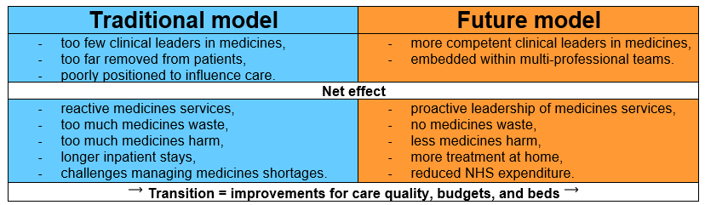
Amser i wneud pethau’n wahanol, i gael canlyniadau gwahanol
Time to do things differently, for different outcomes
Traditional medicines management systems are not fit for the current context¹:-
a growing aging population, with more chronic disease,
taking more complex and personalised medicines for longer.
After staff, the NHS spends most money on medicines. Careful medicines use can be a good investment in improving health but there is a transition we need to make:-
Clinical leaders in medicines = consultant pharmacists
Notes:
1. Royal Pharmaceutical Society. 2023. Prescribing Progress: Transforming Clinical Hospital Pharmacy in Wales for Enhanced Patient Care An Independent Report Commissioned by the Welsh Government. Available at https://www.rpharms.com/Portals/0/RPS%20image%20library/Wales%20Hospital%20Review/Wales%20Hospital%20Report%20%20v11%20%20amended.pdf

Slide 3
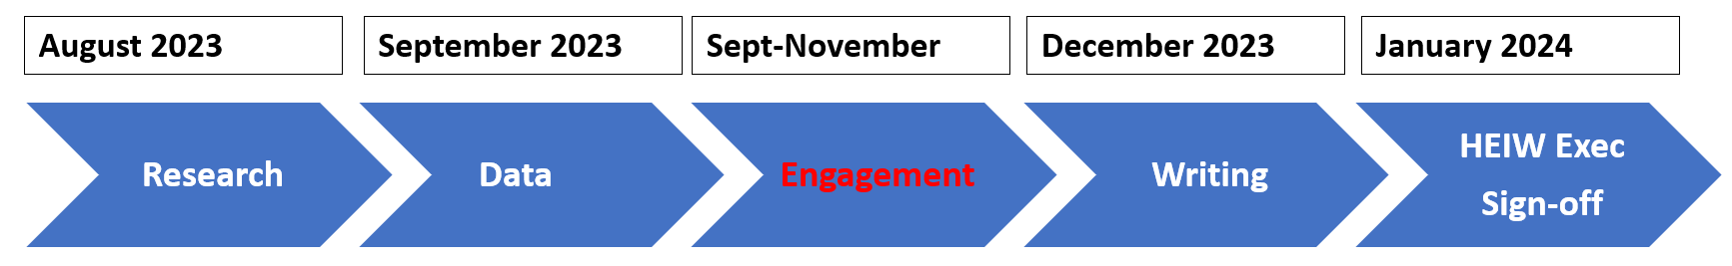
Allbwn Awgrymedig Ionawr 2024
Proposed Output January 2024
A document/toolkit for NHS Wales to facilitate conversations around ‘why?’, ‘where?’, ‘how?’ and ‘how many?’ consultant pharmacists.
To provide clarity on : -
reproducible quality and economic benefits that these roles deliver,
their clinical leadership role in the senior multi-professional team,
the difference between this role and other pharmacy roles (Chief / Advanced Pharmacist),
the clinical leadership role in the pharmacy workforce,
succession planning for roles,
mapping to Professional Framework for Enhanced, Advanced and Consultant Clinical Practice.
Notes:
At the end of the engagement period in November HEIW will be clear what guidance Health Board and Trusts need articulating in this strategic document or tool describing the consultant pharmacist role

Slide 4
Consultant Pharmacists – The most senior clinical leaders in medicines who use their expert knowledge and skills to contribute to the health of individuals and the population by driving change across the healthcare system.
Fferyllwyr Ymgynghorol
4 Pillars
Clinical Expert
Educator role model
Leadership and Management
Research-er
credentialed Beyond advanced practice
Clinical – variable time (max 50-60% usually less) most complex cases, act where evidence lacking
Research leader – PI, furthering the evidence base and embedding
Leadership - Strategic influence across boundaries, to transform
Education – responsibility for multiple professions and population
Notes:
key features are ‘clinical leadership’ and making an impact across boundaries.
There are FOUR absolutely essential aspects to all Consultant Pharmacist roles these are assessed in post applications and individual portfolios
1. Clinical expert 2. Educator and role model 3. Leadership 4. Researcher
Individual credentialing
To ensure patient safety all consultant pharmacists using the title since 2020 must hold the RPS consultant pharmacist credential. This is very rigorous assessment of a clinical portfolio by a clinical competency panel. So far 8 people in Wales hold this credential, with a lot more interest. There are also 13 people already in a consultant pharmacist role who are ‘grandparented’, due to holding the post before the credential was introduced
Post approval
NHS guidance in place in Wales requires posts to be approved through a UK process. This ensures posts are developed strategically in response to local need, facilitate health economy wide working and that the title consultant pharmacist means the same thing wherever you use the NHS in the UK
RPS credentialing process for advanced level pharmacists working in patient-focussed roles wishing to demonstrate that they have the knowledge, skills and behaviours to work at consultant-level.
Approved consultant pharmacist posts are listed on the RPS directory of approved consultant pharmacist posts across England, Scotland, Wales, NI

Slide 5
Title Teitl | Standard Advanced Practice Pharmacist Fferyllydd Ymarfer Sylfaenol Uwch | Chief Pharmacist/Director of Pharmacy Prif Fferyllydd/ Cyfarwyddwr Fferylliaeth | Regional Consultant Pharmacist Fferyllydd Ymgynghorol Rhanbarthol
Typical average split of time in each pillar of practice
Role over-view | Experienced pharmacists delivering care to individuals and defined groups with complex medicines needs, typically in one site/org or may be >1 where capacity allows | Responsible for pharmacy staff and corporate medicines services in the organisation being compliant with legal and professional regs. | A senior clinical expert, delivering care and driving change via an MDT for a specific population across traditional health boundaries recognised expert in the clinical field
NHS Posts | 500 | 8 | 13
Typically leads | 0-5 people (estimated >90% pharmacy staff groups) | 30-300 people (estimated >80% pharmacy staff groups) | 0-20 people (45% none pharmacy staff groups)
Notes:
A question often asked is How is the consultant pharmacist role different to other pharmacist roles?
Advanced clinical pharmacists are not adequately positioned for strategic influence.
Chief pharmacists can’t maintain ‘expert knowledge’ in all clinical areas, they have many responsibilities around governance.
There was a gap that consultant pharmacist roles have filled which are formal senior clinical leadership roles based within the multi-professional teams in areas where medicines are complex.
Postholders collaborate closely and have influence from within the team, this impacts positively downstream for anyone involved in delivering medicines processes as care is taken to set up each step for success.
The posts lead the whole clinical team on safe prescribing, education and research on medicines and they manage the cases with the most complex medicines. Furthermore they look at how medicines will be provided and monitored as the mainstay of treatment for the chronic disease when people transfer from one healthcare setting to another, which is usually where things go wrong. No other health professional is interested or responsible for getting medicines right for people across the interface.
Post holders tell us that Pharmacist professional standing amongst medical, nursing and other peers is improved with the title and post of consultant pharmacist
With more pharmacists in advanced prescribing roles more clinical leadership of this emerging part of the workforce is needed
Look how well proportioned the Consultant pharmacists time is across the 4 pillars of practice compared to the other roles. This is the key to unlocking many NHS problems having individuals with the skill and knowledge across this breadth of experience strategically placed to influence for the right action in the right place for the current context.

Slide 6


Astudiaeth Achos Cymru - Wales Case Study
Renal Consultant Pharmacist
Swansea Bay University Health Board
Embedded in the clinical team for >10 years
Video Link
  - Stopped doing things that didn’t work
  Designed an Electronic Prescribing and Medicines Administration system with patients and staff
  Reduced medicines waste
  Reduced medicine errors
  Grew the pharmacy team to deliver millions of pounds of recurrent savings on medicines annually
  Allowed more people to have successful transplants
  More dialysis at home
  Better clinical outcomes from optimal medicines use
2022 Ministerial visit as Transformation Funding expands regional benefits to all of Wales
Notes:
Swansea Bay University Health Board: Since creating Wales’s first consultant pharmacist post a decade ago, Chris Browns legacy is a transformed renal service across Wales.
An exemplar of what can be achieved through the clinical leadership of a competent consultant pharmacist, completely integrated with the service user and clinical team. Chris and the team’s work has liberated millions for reinvestment, including more staff and improved services, including dialysis and transplant.
The role created is now responsible for multi-million pound budgets and complex chronic conditions. Any future postholders will require the RPS consultant pharmacist credential before using the title Consultant Pharmacist
Pharmacy-led projects secured through this Consultant pharmacist post have secured Welsh Government Transformation funding, featured in Prudent and Value Based Healthcare case studies, and have attracted Ministerial visits since 2018.
Examples in these Wales case studies are posts line managed outside of the pharmacy team
Renal Consultant Pharmacist and Mental Health Pharmacists reports to respective clinical directors

Slide 7
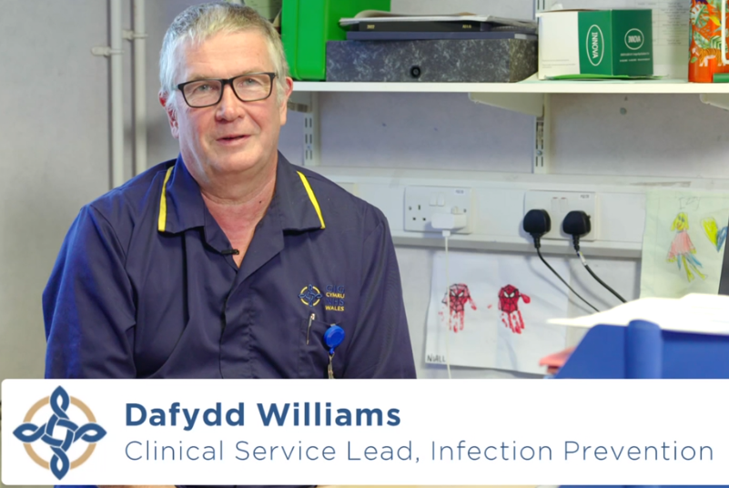
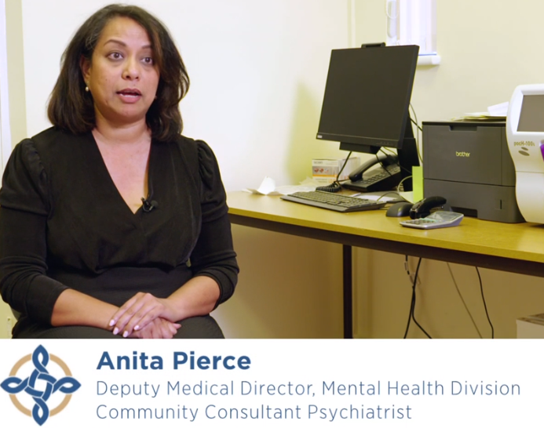
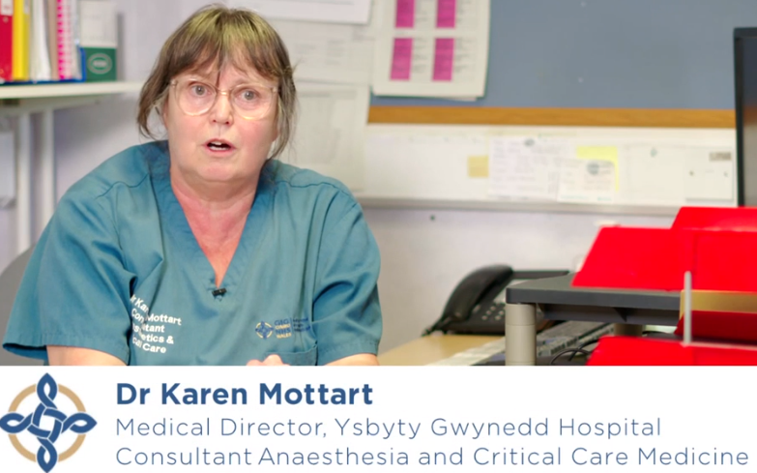
Astudiaeth Achos Cymru
Wales Case Study
Betsi Cadwaladr University Health Board
Problem: Two medical consultant vacancies
Solution: Two consultant pharmacists
Game changer: senior clinical leadership on medicines use within the existing multi-professional team.
Pay-off: parenteral anti-biotics at home, more mental health care in the community, new digital medicines systems, improved knowledge in medicines for doctors and nurses, All-Wales research published in the Lancet
Follow link to Play video here
Notes:
Hightail – Receive Just press play – no need to download

Slide 8

Canlyniadau Ymchwil a Data
Research and Data Conclusions
The clinical leadership of consultant pharmacists, improves care and brings economic benefits that are reproducible in any geography or speciality where:-
they work in multi-professional teams
there is a population need for improved clinical outcomes, and
treatment includes complex medicines
Consultant pharmacist roles consistently deliver safer, seamless and more person-centred care in the target population than before intervention.
MAIN BODY (Click to edit)
Notes:
This can be explained by the ‘upstream’, strategic intervention, that only consultant pharmacists can achieve due to their senior respected position in the clinical team.
Strategic clinical intervention reduces work of everyone involved in medicines processes further down stream and improves continuity of care across health interfaces for patients because all roles have been set up for system wide leadership across boundaries.

Slide 9

Ar gyfer y newidiadau mae GIG Cymru angen eu darparu
For the changes NHS Wales needs to deliver: -
… pharmacists must be positioned in influential senior clinical roles, where they will research, educate and lead on improving medicines use from within multi-professional teams
Consultant pharmacists are
Senior pharmacists with expert clinical skills in practice, (NHS Band 8b, Band 8c or Band 8d)
Change agents: capable of leading service transformation across the Health Board, region or Wales in relation to medicines use, governance and public health.
Influencer at Director and Executive level
Holders of RPS Consultant Pharmacist Credential (introduced in 2020, previous post holders have been ‘grandparented’ in their current role)
Appointed to a post listed in the RPS Directory of Consultant Pharmacists

Slide 10
Cwestiynau Ymgysylltu
Engagement questions
What is your local experience with consultant pharmacist roles?
How clear is the evidence around the business need for consultant pharmacists?
What else needs to be included about positioning the role?
What is the most helpful format for a HEIW publication on this topic?
What are your priority clinical area for improvement? Health Board/Trust/Wales?
How significant is the role of medicines in the prevention, treatment or cure of this clinical area?
What is the current level of medicines costs, waste and avoidable harm and errors associated with this speciality?
Considering the speciality, what level of consultant pharmacist input is needed? Health Board, Regional or National? So, who are your partners in creating a role?
Considering where the population are, would the role benefit most from being located in a tertiary hospital, general hospital, primary care, cluster?
You can answer our survey questions here English Cymraeg

