Slide 1
Addysg a Gwella Iechyd Cymru Health Education and Improvement Wales
Cyfarfod Cyffredinol Blynyddol
24 Medi 2020
Annual General Meeting
24 September 2020

Slide 2
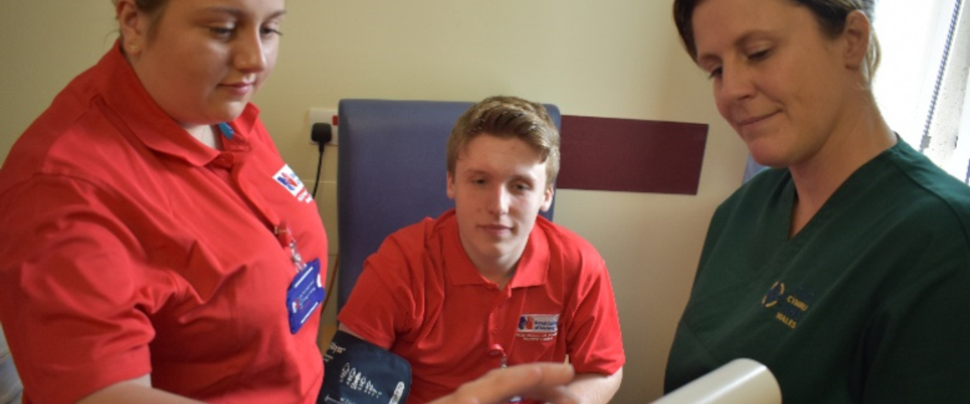
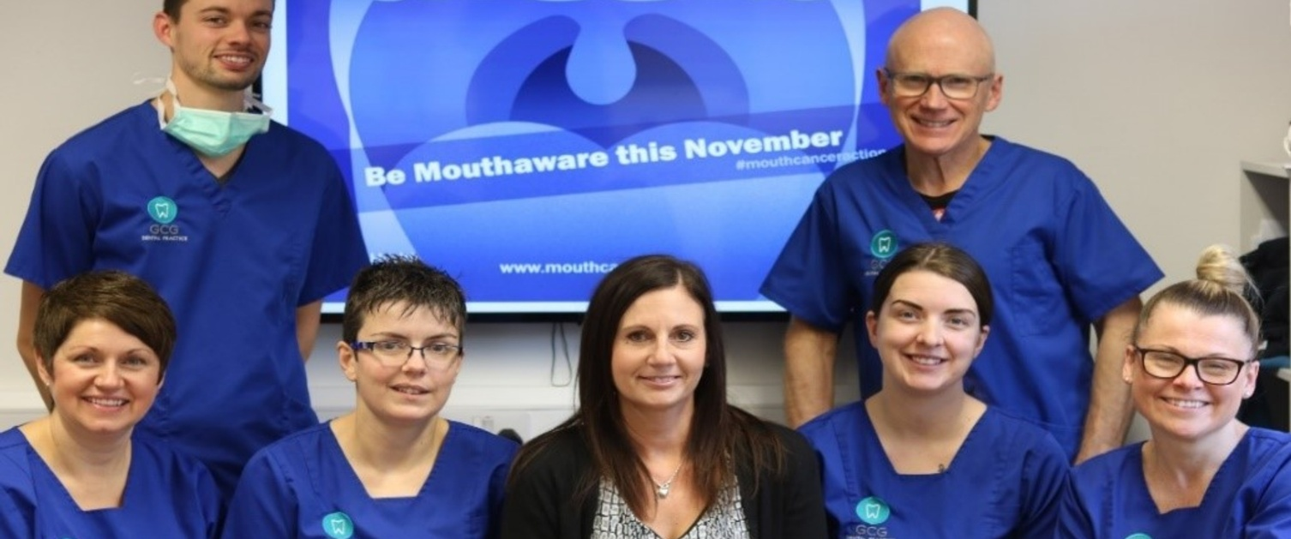
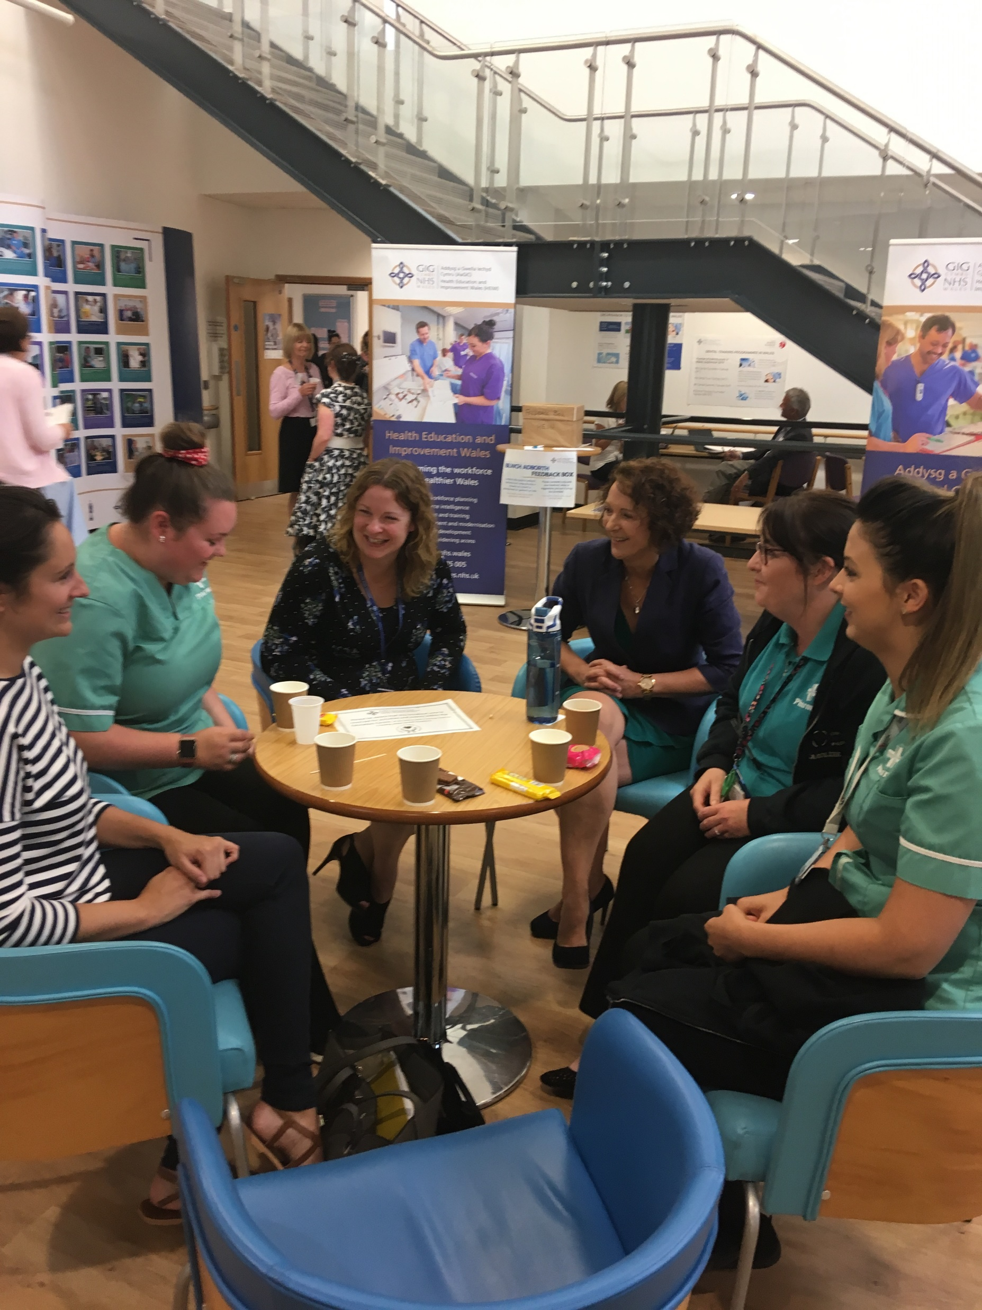
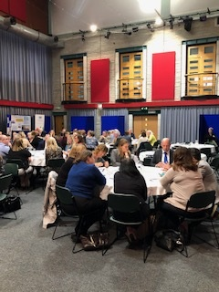
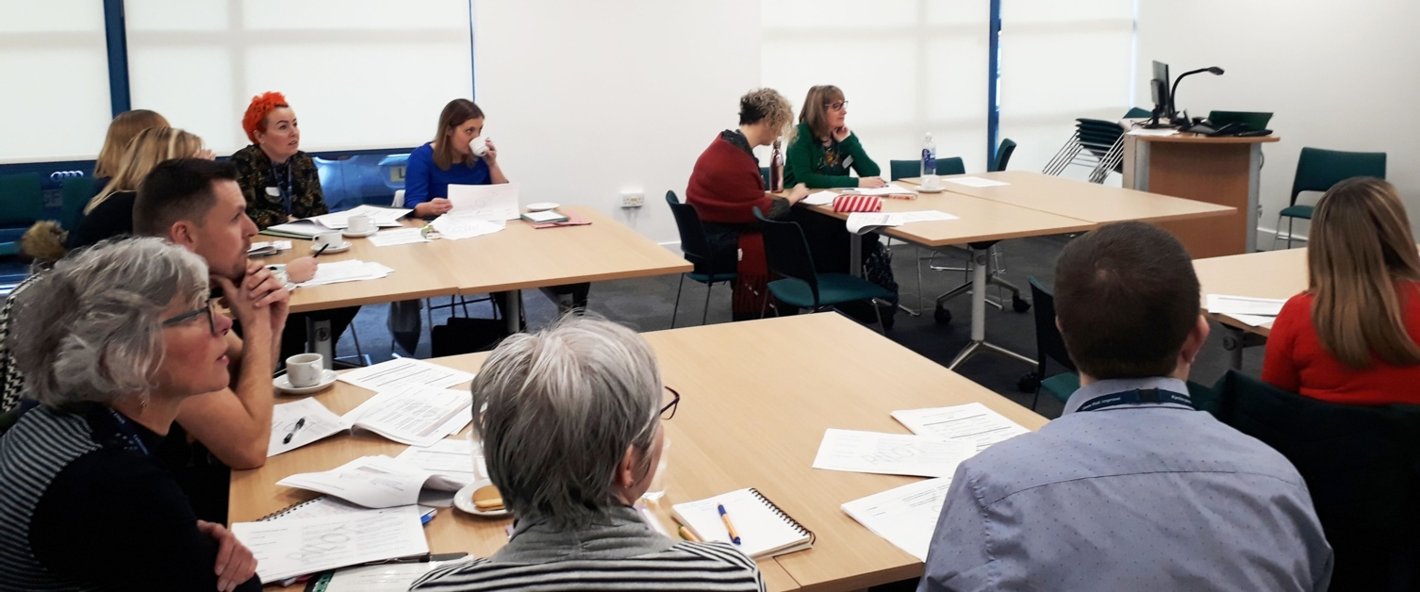
Dr CDV Jones, Cadair Chairman
Croeso a Chyflwyniad
Welcome and Introduction

Slide 3
Agenda (Cadeirydd Chairman)
Overview of HEIW in 20/19 – Alex Howells, Chief Executive
Workforce Strategy for Health and Social Care – Julie Rogers, Director of Workforce and OD
Developments in Education and Training – Professor Pushpinder Mangat, Medical Director and Dr Angela Parry, Director of Nursing
Financial Performance in 20/19 – Eifion Williams, Director of Finance
Receive and Approve the Annual Report – Chairman
Forward Look for 20/21 – Alex Howells, Chief Executive
Welsh Language – Dafydd Bebb, Board Secretary
Discussion Session - Chairman

Slide 4
Alex Howells, Prif Weithredydd Chief Executive
Trosolwg/ Overview of 2019/20

Slide 5
FUNCTIONS
Workforce Strategy
Workforce Planning
Workforce Intelligence
Education and Training – Medical, Dental and Pharmacy Deaneries
Education and Training - Commissioning
Careers and Widening Access
Workforce Modernisation
Leadership
Ein Pwrpas
Our Purpose
…a single body to develop an integrated and comprehensive approach to the planning and development of the health workforce.
….to deliver improvements to safety and quality – for patients, for staff and the system.
Ein Gweledigaeth
Our Vision
Transforming the Workforce for a Healthier Wales

Slide 6
Trosolwg Overview of 19/20
Integrating and growing HEIW as a great place to work
Business continuity for our service users
Good governance
Developing the workforce strategy for Health and Social Care
Championing compassionate and collective leadership
Planning ambitious increases in education and training
Innovating and improving education and training programmes
Plugging our expertise into key service delivery challenges
Working with partners and our NHS colleagues
Delivering on our financial targets

Slide 7
COVID-19
CEO secondment to WG
Pause of non-time critical objectives to release capacity and resources
Ability to move to a remote operating model within 24 hours
Good governance maintained
Significant adjustments to education and training programmes with regulators, education providers and the NHS
Step change in delivery of digitally enabled education, training and CPD
Accelerated delivery of wellbeing resources and support for staff
Commissioning of additional targeted training eg in critical care

Slide 8
Julie Rogers, Cyfarwyddwr y Gweithlu a DG/ Director of Workforce and OD
Strategaeth y Gweithlu ar gyfer
Iechyd a Gofal Cymdeithasol
Workforce Strategy
for Health and Social Care

Slide 9

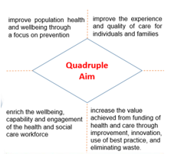
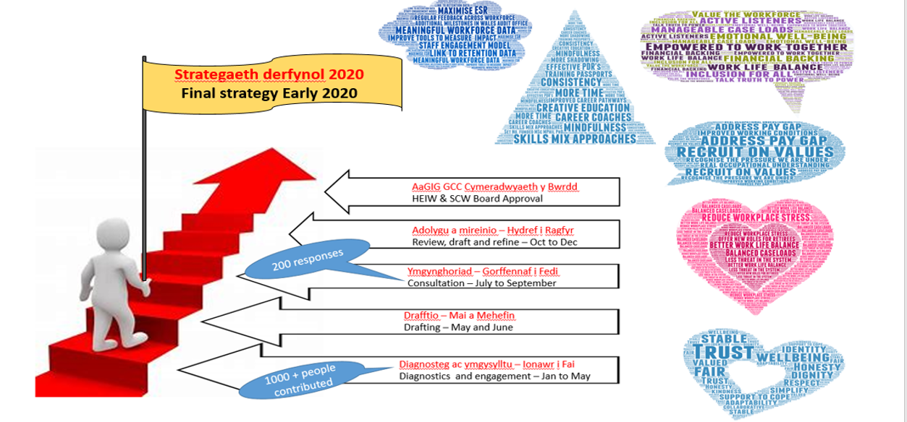
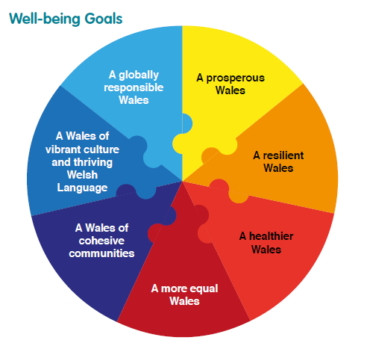

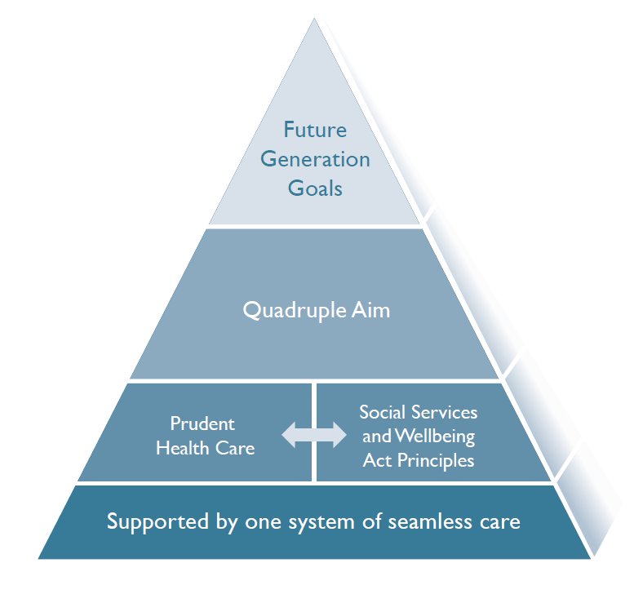

Sut y datblygwyd strategaeth y gweithlu How we developed the workforce strategy
Context
Consultation and Engagement
Notes:
Points to note – developing the strategy
Case for change set in context – FGA, importance to the economy – Health and Care’s wider contribution to economic prosperity
Complexity of the case for change emphasises the need for flexibility in the workforce strategy because the pace of change, to avoid a strategy that is out of date as soon as it is produced
Staff expectations – millennials are known to want variety, fast progressing careers, rewards for hard work, significant breaks from careers, work life balance etc. they now make up one third of the workforce
Well Being – NHS staff survey has shown increases in bullying and work related stress
Digital – in next 20 years 90% of all jobs will require digital skills
Shortages in some professions
Widening Access and building equality / diversity / inclusion
Points to note – consultation and engagement
ENGAGEMENT PHASE
46 x 121 phase 1 interviews
43 x 121 phase 2 interviews
36 peer group meetings attended
40+ attended webinars
290 attended one of the 14 stakeholder workshops
327 usable online questionnaire responses
CONSULTATION PHASE
137 online questionnaire responses
63 written responses
*As engagement continued throughout the summer consultation period with additional contacts it’s estimated over 1,900 people in total contributed.
WHAT WE HEARD
Overall commitment to supporting health and wellbeing of workforce and culture of compassionate care
WL– had a separate discussion with key partners and is a ‘golden thread’ throughout
details of action and ownership will need to be in the implementation plan – as this will need to be co produced
Ref to current political developments e.g. Brexit is light as want to ensure the strategy has longevity (some details also in implementation plans)
In particular bolder on equality & diversity and parity of esteem –strengthen the need to change the relationship between the workforce an individuals – choice, control and co-production; equity of employment; managing governance to support new workforce model; digitalisation; wellbeing of the workforce; importance of third and private sector and commissioning relationship with the public sector; importance of workforce efficiency and productivity – all were made more visible and incorporated in each of the themes

Slide 10
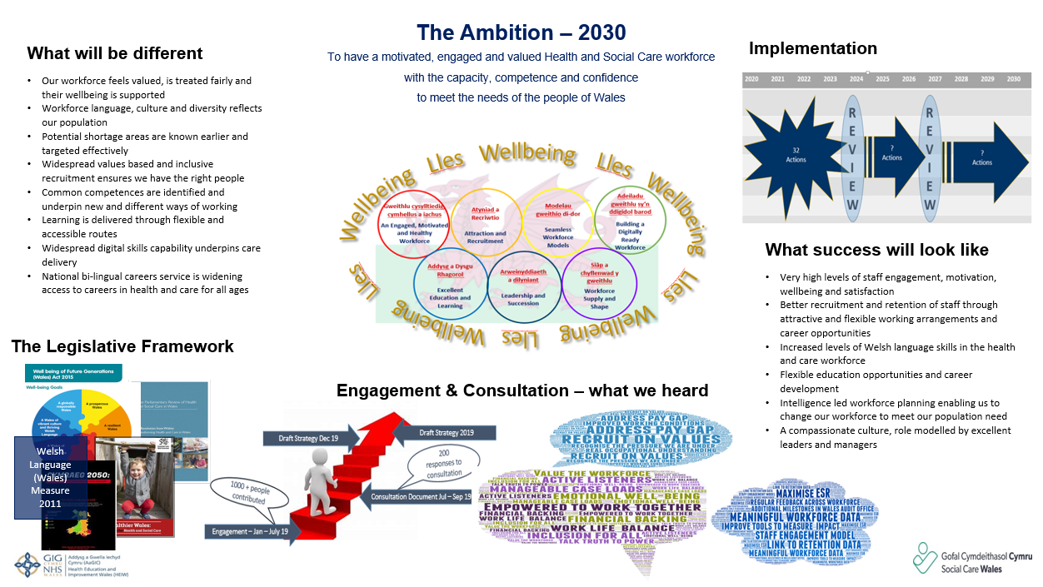
Strategaeth y Gweithlu ar gyfer Iechyd a Gofal Cymdeithasol
The Workforce Strategy for Health and Social Care
Notes:
Points to Note – this is the strategy on a page
Sent into Govt on 20th December a quality product, on budget and within timeframe
During June we reviewed the strategy to assess whether our covid experience altered our thinking – it didn’t, but
Our review following covid idenitifed 5 critical themes
Wellbeing
Leadership
Changes to the way we deliver excellent Education and learning
Workforce Data and Intelligence – we were unable to give an understanding of the shape of the workforce in real time.
Grow your own - this is specifically as a response to the workforce shortages we experienced
Have founded our Winter protection plan on the foundations of this strategy
Work is progressing
We await further information regarding publication and implementation.

Slide 11
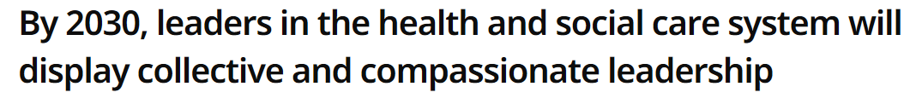
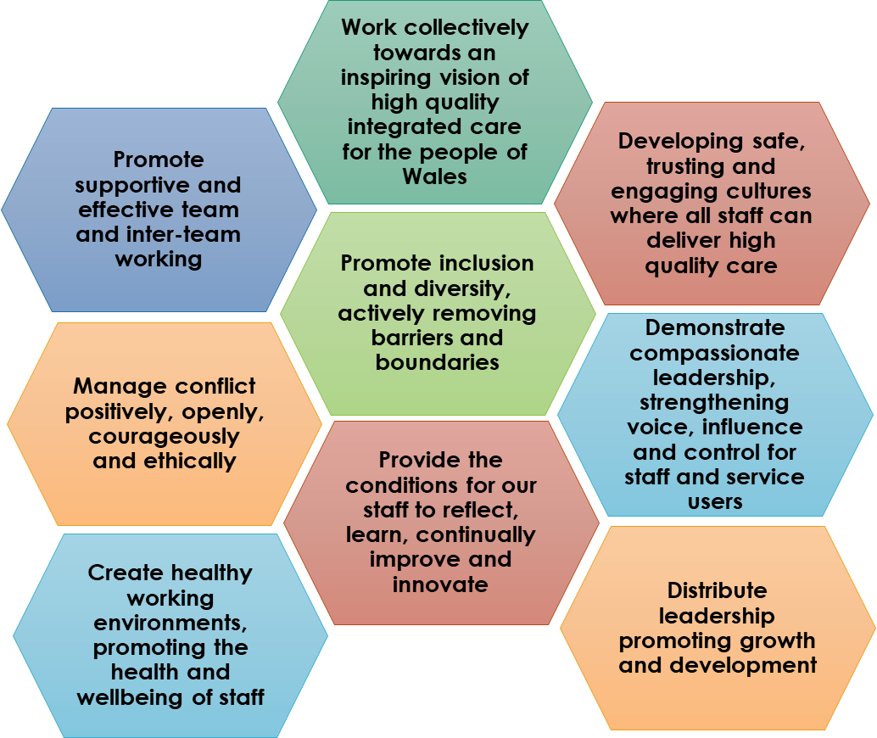
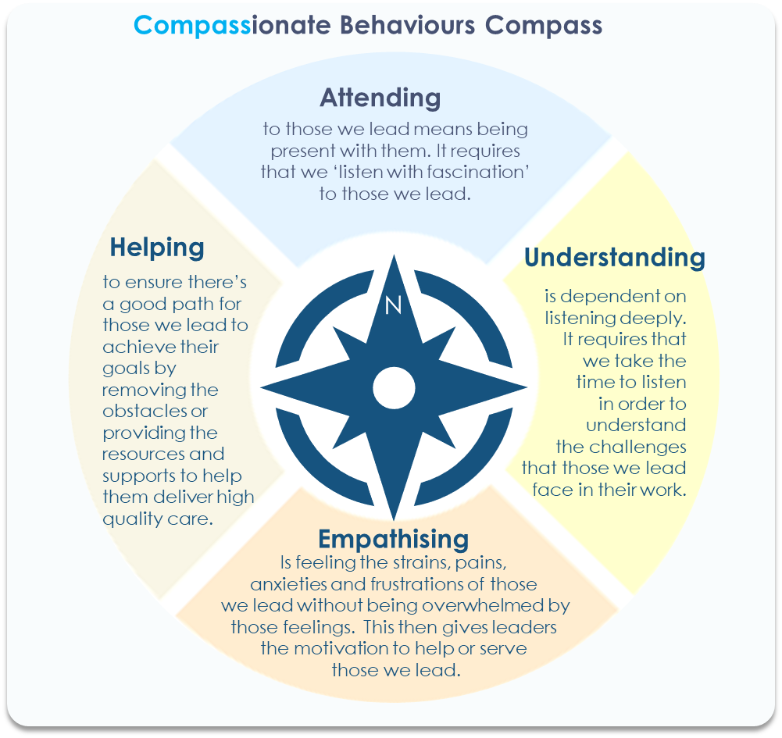
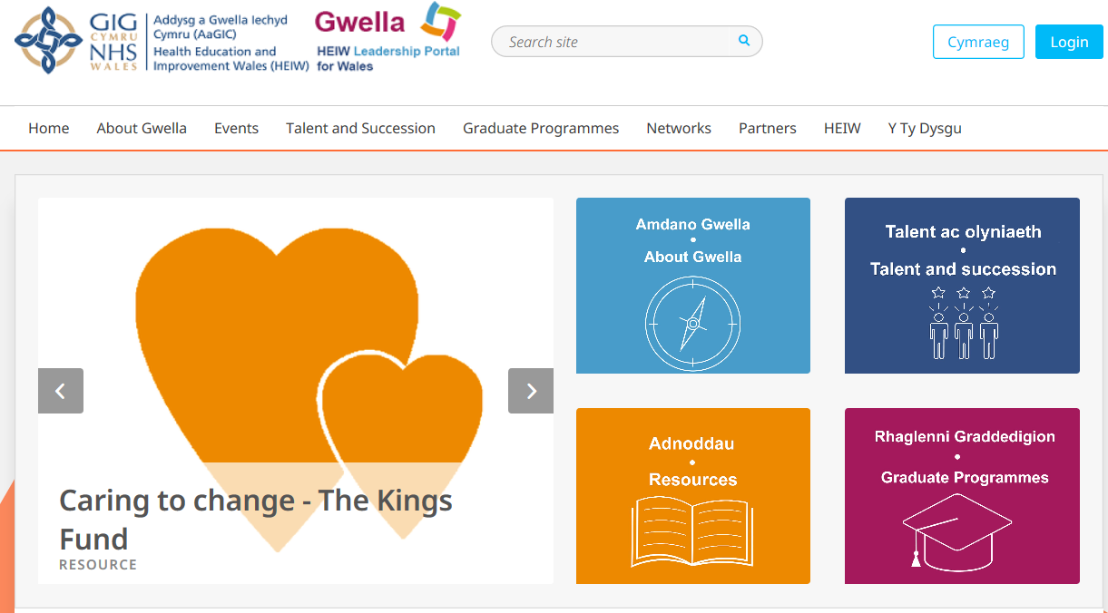
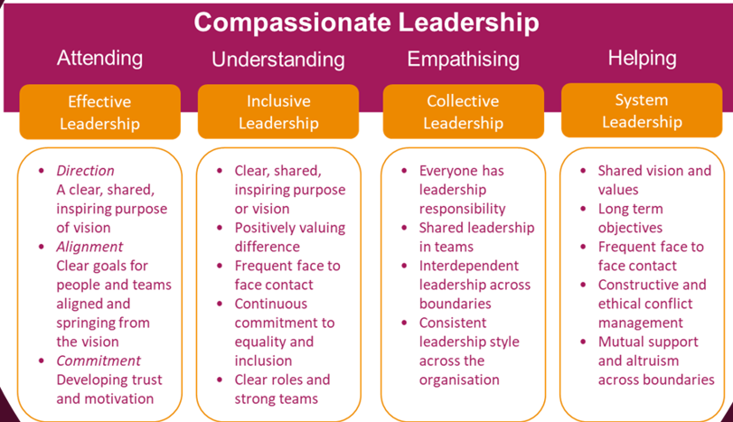


Ein Gweledigaeth Our Vision
Compassionate leadership is needed to instigate change, empower others and create the conditions so our staff are engaged, empowered and as a result able to provide high quality, continuously improving care for our communities.
There is a significant range of evidence supporting the need for compassionate leadership. These resources can be freely accessed through the accessible HEIW Gwella Leadership Portal.
Compassionate leadership principles have been developed through extensive engagement to guide us as a system to work collectively across boundaries promoting inclusion, equality and the health and wellbeing of our staff.

Slide 12









Pyramid o Gymorth Iechyd a Gofal/ Health and Wellbeing Pyramid of support
Blue - local support
Green - organisational support and resources
Pink - national support and resources
Helplines
Emotional Wellbeing
Physical Wellbeing
Our Wellbeing Matters and Manager Wellbeing Matters
Support from manager
Support from local team
Online resources and Apps
Organisation support and resources:
HEIW
Cuppa Catchup, A Friendly Ear, Community Hub, Health and Wellbeing intranet page, financial services, Cardiff and Vale Employee Wellbeing Resources
Leading with Compassion through the COVID-19 Pandemic
HEIW Website - COVID-19 Health and Wellbeing National Resource
Notes:
Nationally, there are 3 national groups: MAAW Project Group (group that reviewed that developed the MAAW policy), Occupational Health Project Group (group that managed the review of occupational health services in Wales) Health and Wellbeing Network (developed the Our Wellbeing Matters and Manager Wellbeing Matters products and the national conference).
In addition during COVID-19 HEIW led on the developed of a national resource, as a one stop shop for all support and information for staff in NHS Wales and was involved in the extension of the Health for Health Professionals resource for all staff in NHS Wales. HEIW continue to provide expert advise and programme management resource for the COVID-19 Health and Wellbeing sub group of the Workforce Cell (group that led on the developed of a health and social care Samaritans helpline in Wales.
HEIW – as well as providing a dedicated staff intranet page for staff health and wellbeing, additional resources were also provided for COVID-19. HEIW is being used to pilot initiatives which can then be transferred to a national stage e.g. Health Needs Assessment.

Slide 13
Yr Athro/Professor Pushpinder Mangat, Cyfarwyddwr Meddygol Medical Director Dr Angela Parry, Cyfarwyddydd Nyrsio Director of Nursing
Datblygiadau mewn Addysg
Developments in Education

Slide 14
Beth yw ein swyddogaeth addysg a hyfforddiant? What is our education and training function?
Profession | Educational Programmes
Medical | Foundation, Specialty, GP Trainee and SAS grade doctors
Dental | Dentists and the wider dental teams
Pharmacy | Pharmacists, technicians and support staff
Health Professions | Therapists, Scientists, Nurses, Midwives, Community Nurses, Paramedics, Physicians Associates, Optometrists
Support staff | Health & Social Care vocational qualifications, Health Care Support Worker development
Multi professional | Advanced Practice, Independent Prescribers
Plannning
Commissioning
Delivery
Quality Management

Slide 15
Deoniaethau AaGIC – Meddygol, Deintyddol a Fferylliaeth
HEIW Deaneries – Medical, Dental and Pharmacy
Delivery of high quality, managed training programmes for
58 training disciplines in Medicine (F1-ST8).
Dental Foundation, Core and Specialty training
Preregistration Pharmacists, and extra training in Advanced Practice
Recruitment, management and progression reviews of all the above
Single Lead employer process for all postgraduate trainees
Quality assurance processes aligned to each regulator
Professional Support for postgraduate trainees

Slide 16
Cyflawniadau mewn Deoniaethau Meddygol, Deintyddol a Fferylliaeth Achievements in Medical, Dental and Pharmacy Deaneries
Commenced wide focus on Differential Attainment
Implementation of new Model for GP trainees
Expansion of Medical Foundation Numbers – focused on Primary Care
Professionalisation of Medical Educators
Respond to changing needs for Medical Appraisal during COVID-19
Launch of Orbit 360 (New in house Multisource feedback tool)
Multisector Preregistration Pharmacy training – Unique in the UK
Training of 35 GP Practice Pharmacist, 40 Independent Prescribers
Multisector Pharmacy Technician training
17 Pharmacy Technicians undergoing Advanced Practice Training
Dental Foundation plus year to encourage retention of Dentists in Wales
Development of All Wales Dental Care Practitioner faculty at Bangor University

Slide 17
Y Llwybr Gyrfa Addysg ar gyfer Iechyd a Gofal Cymdeithasol – Dysgu Seiliedig ar Waith The Education Career Pathway for Health & Social Care – Work Based Learning
Supports career progression and role extension
Accredited education developed by NHS Wales subject experts
Previously heavily support worker focussed at levels 2 - 4
More recently higher level work based learning has been developed at levels 6 & 7
WG development partner for health apprenticeships
Developing strong links with professionally regulated courses re: Level 4 developments to allow for progression to professional registration
Plans to centrally commission the level 4 Certificate in Higher Education for Nursing Support Workers – tied into new Health professional Education Contract
Increased financial support to NHS Wales to support WBL
Mirrored developments between Primary and Secondary Care
Close working with Social Care Wales to develop the wider health social care workforce

Slide 18
Y Llwybr Gyrfa Addysg ar gyfer Iechyd a Gofal Cymdeithasol - cynnydd mewn addysg ôl-gofrestru The Education Career Pathway for Health & Social Care – increases in post reg education
Advanced Practice education programmes
Extended Practice education programmes
Non-Medical Prescribing
Community education for nurse and therapy roles
Return to Practice programmes
Medical ultrasound
MSc Genomic medicine
Equivalence education pathways for healthcare scientists
SCPHN – Health Visiting, School Nursing and Occupational Health Nursing
SPQ - District Nursing, Practice Nursing, Community Paediatric Nursing, Community Psychiatric Nursing, Community Learning Disability Nursing
Additional module funding to support CPD across all professions working in a community role

Slide 19
Golwg strategol ar Addysg Broffesiynydd Iechyd
Strategic review of Health Professional Education
The new contact will,
Redefine the ‘shape’ of Health Professional Education in Wales
Support 3,400+ nursing, midwifery, AHP and Healthcare Science into training each year
Set the strategic direction of Health professional Education in Wales for the next 10 years.
Focus on widening access
Increase and strengthen placements in Primary, Social and Community care
Facilitate care closer to home and a whole system approach to health and social care building upon the strategic directions set out in ‘A Healthier Wales’.
Key Themes
HEIW developing its role in supporting newly qualified staff
Further development of a strategic role in placement provision
Local / regional approach to commissioning where appropriate
Using technologies to enhance teaching, student support and placement preparation & integrate the digital environment into learning.
Develop education and training across the whole career pathway
Establish an enhanced approach to inter-professional education
Developing flexible routes
Closer Regional Collaborative Education Consortium working arrangements
Improve responsiveness to Service Need/WG Policy
Supporting students from disadvantaged backgrounds
Distance and Dispersed Learning
Compassionate Leadership

Slide 20
Datblygu addysg a hyfforddiant aml-broffesiynol Developing multi professional education and training
Multi professional education and training group
Multi professional simulation
Welsh Clinical Leadership Fellows Programme
Quality Improvement
Development of Primary Care Training Academies

Slide 21
Eifion Williams, Cyfarwyddwr Cyllid Director of Finance
Trosolwg Ariannol a Chyfrifon ar gyfer 19/20
Financial Overview and Accounts for 19/20

Slide 22
Perfformiad Ariannol 2019-20 Financial performance
For the 2019/20 year, the financial performance of HEIW was as follows:
Against a Revenue Allocation from Welsh Government of £213.1m, there was an underspend of £84k.
Against a Capital Allocation of £95k from Welsh Government, there was an underspend of £0k.
During the financial year, 95.2% of Non-NHS Invoices was paid within 30 days.
These results, together with the approval of its 2020-23 IMTP enabled HEIW to meet its Statutory and Public Sector Payment Policy financial targets.

Slide 23
Perfformiad Ariannol 2019-20 Financial performance
For 2019/20 the following expenditure was incurred by HEIW:
£76.2m. was spent in training Hospital Doctors, General Practitioners, Pharmacists and Dentists
£69.7m. was spent in educating and training Nurses, Health Visitors and Midwives
£40.2m. was spent in educating and training other staff including Physiotherapists, Occupational Therapists, Dieticians etc.
£14.6m was spent on HEIW staffing
£12.2m was spent on non-pay costs

Slide 24
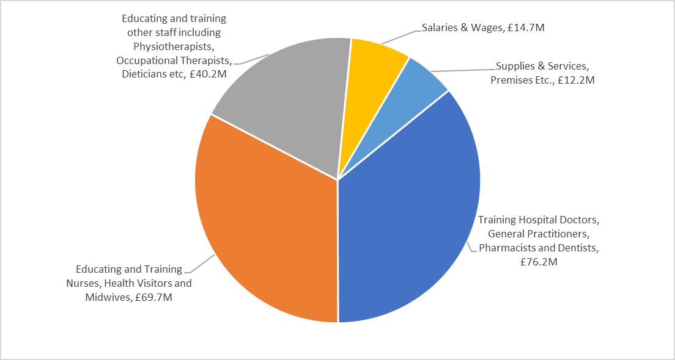
Perfformiad Ariannol 2019-20 Financial performance
For the 2019/20 Financial Year, HEIW spent £213.0m on the following areas:

Slide 25
Argymhelliad Recommendation
Derbyn a Chymeradwyo'r Adroddiad Blynyddol
Receive and Approve the Annual Report

Slide 26
Edrych Ymlaen Forward Look
2020/21
Alex Howells,
Prif Weithredydd
Chief Executive

Slide 27
Cydbwyso blaenoriaethau yn y misoedd i ddod Balancing priorities in the months ahead
Continue to support COVID 19 work and the Winter Protection Plan – care homes, wellbeing, rehabilitation, infection prevention and control training, vaccinations, surge capacity
Continue to flex our operating model in HEIW to meet business and staff needs
Pick up the pace on key strategic commitments in the workforce strategy;
Talent management and succession planning
Strategic review of health professional education
Digital agenda
Staff Governance Framework
Pick up the pace on key commitments in our IMTP
Research and improvement
Simulation
Primary Care
Mental Health
Cancer

Slide 28
Dafydd Bebb, Ysgrifennydd y Bwrdd Board Secretary
Yr Iaith Gymraeg
Welsh Language

Slide 29

Ein Nodau - Y Gymraeg
Our Aims - Welsh Language
Approval of Language Scheme by the Welsh Language Commissioner and Board
Continue to implement and monitor HEIW Welsh Language policy
Increase the use of Welsh across HEIW’s functions
Ensure our strategic commitments seek to strengthen Welsh Language services:
Education Commissioning Process
Joint Workforce Strategy for Health and Social Care
Compassionate Leadership
Provide online courses to strengthen Welsh Language skills

Slide 30
Dr CDV Jones, Cadair Chairman
Sesiwn Holi ac Ateb
Question and Answer Session

Slide 31
Sylwadau i Gloi Closing Remarks
Diolch
Thank you

